Slide 1
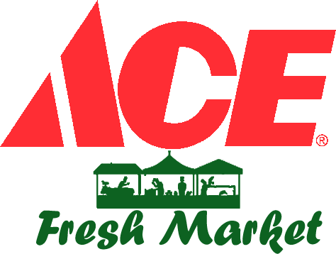
Increasing customer engagement and sales through ai
IBM AI Team 3: Neo Say Chao / Julia Ge / Colin Sun / Eugene Ang
12 Sep 2022
Notes:
Good morning/afternoon everyone. Team 3 comprises of Neo Say Chao, Julia Ge, Colin Sun and myself, Eugene Ang and we are pleased to present to you, our AI project “Increasing customer engagement and sales through AI”.

Slide 2
Agenda
Topic Presenter
Project overview Eugene Ang
Enterprise design thinking Eugene Ang
AI design essentials Eugene Ang
Demo of our AI product Neo Say Chao
Project planning and design Neo Say Chao
Model and website design, implementation and deployment Colin Sun
Chatbot design, implementation and deployment Julia Ge
Future iterations / MVPs Neo Say Chao
Project learnings Colin Sun
Notes:
I will cover the first 3 sections, “Project overview, Enterprise Design Thinking and AI design essentials” to give you the background how we ended up with our AI solution which includes an AI predictive model and a chatbot. Say Chao will then provide you with a demo and go through with you how we did “Project planning and design”.
Thereafter in section 6, Colin will go through the model and website design. Julia will go through the chatbot in Section 7. Say Chao will then come back again to talk about our future iterations and MVPs in Section 8 and Colin will finish up with Project Learnings in Section 9.

Slide 3
detailed Agenda
Project overview
Project objectives
Project topics
Team member task allocation
Enterprise Design Thinking
The problem
User persona
Pain points
Problem statement / How might we?
Business opportunity
AI design essentials
AI intent
Big ideas prioritisation grid
Big idea!
Data
Understanding
Reasoning statement
Knowledge / AI Ethics
Demo of our AI product
Our product (Responsive Hybrid Website)
Project planning and design
Project planning and timeline
Technical planning and considerations
Model considerations
Website development considerations
Development to deployment overview
Libraries to support the website
Overall implementation overview
Website and model design + implementation and deployment
Overview of application flow
Application flow details – Flask framework (Methods 1 and 2)
Our prediction model
Data understanding
Data cleansing
Data preparation
Tuning and testing the deep learning prediction model
Prediction result
Notes:
In the next 2 slides, we have the detailed agenda to give you an idea what we will be covering. There is a lot to unpack here, 80 plus pages and a demo, so let’s just go straight into the materials.

Slide 4
detailed Agenda
Chatbot design, implementation and deployment
Chatbot purpose and design
Chatbot creation on Watson Assistant
Dialog creation – Intents
Dialog creation - Entities
Overview of conversation flow
Translating conversation flow to dialog nodes
Embedding chatbot onto website
Chatbot integration / technical architecture
Sample chatbot screenshots
Future iterations / MVPs
ACE MVP Roadmap
Chatbot report (MVP 1.1)
Sales report (MVP 1.1)
A Shopper’s future journey (MVP 2.0)
Project learnings
Constraints and challenges
Project takeaways
Questions & Answers

Slide 5
Section 1: Project overview
Notes:
Section 1, project overview.

Slide 6
PROJECT OBJECTIVES
Objective
To use AI to increase customer engagement and sales for a local supermarket chain, ACE Fresh Market.
Background
More than 87% of Singaporeans now shop online (Statista and Rakuten, Oct 2021) and more than half of Singaporeans shopped less frequently in physical stores (Visa, 3 Sep 2021)
Local supermarkets face intense (both online and offline) competition for customers, rising business costs due to inflation and manpower shortages
Successful supermarkets are those who can use AI and cloud technologies to enhance their customers’ engagement 24/7 while optimizing their employees’ time to do higher value tasks
Notes:
[Read from text]

Slide 7
PROJECT TOPICS
AI driven customer engagement tools and their features | Predictive model on website | Chatbot
Predicts the type of dish based on pictures uploaded to the website by the user | ✓
Query for information about the dish | ✓ | ✓
Provides recipe suggestions for the dish predicted or queried | ✓ | ✓
Provides ingredient list of recipe suggested: Easy to use links to the supermarket e-commerce website for the user to order online Sends a downloaded copy to user’s device if the user wants to visit a physical store to buy | ✓ | ✓
Tells context-specific jokes to engage customer and informs user on latest promotions and where items are located in the store |  | ✓
Allows feedback channel for customers to provide both positive and negative feedback | ✓ | ✓
Provides answers to FAQs for customers in real time so that customers can be engaged 24/7 and relieves staff from the routine work | ✓ | ✓
Notes:
Project topics: Essentially, we will talk about the two AI tools which we have developed, a binary classification predictive model on a website and a chatbot with these features:
Firstly, the model can predict the type of dish based on pictures uploaded to the website by the user
Users can query for information about the dish
The website and chatbot can provide recipes for the dish predicted or queried
They both can also provide the ingredients for each recipe and easy to use links to the supermarket’s e-commerce website for the user to order online or can send a downloadable copy to the user’s device if the user wants to physically visit a store to buy these ingredients
The chatbot can tell jokes which are context specific to inform the user on the latest promotions and where these items can be found in the store
It allows a feedback channel for customers to provide both positive and negative feedback
And provides answers to FAQs for customers in real time so that customers can be engaged 24/7 and relieves staff from the routine work so that they can focus on higher value work

Slide 8
TEAM MEMBER TASK ALLOCATION
Customer engagement tools | Team members
Predictive model + website | Neo Say Chao, Colin Sun
Chatbot | Julia Ge, Eugene Ang
Notes:
Team member task allocation. Say Chao and Colin worked on the predictive model and website while Julia and I worked on the chatbot.

Slide 9
Section 2: Enterprise design thinking
Notes:
Section 2: Enterprise Design Thinking

Slide 10
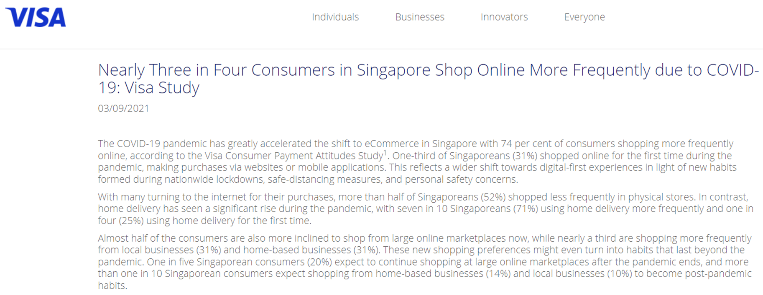
The problem: Physical Supermarket sales are under threat
Source: VISA Inc press release on 3 Sept 2021
Notes:
The problem: physical supermarket sales are under threat.

Slide 11
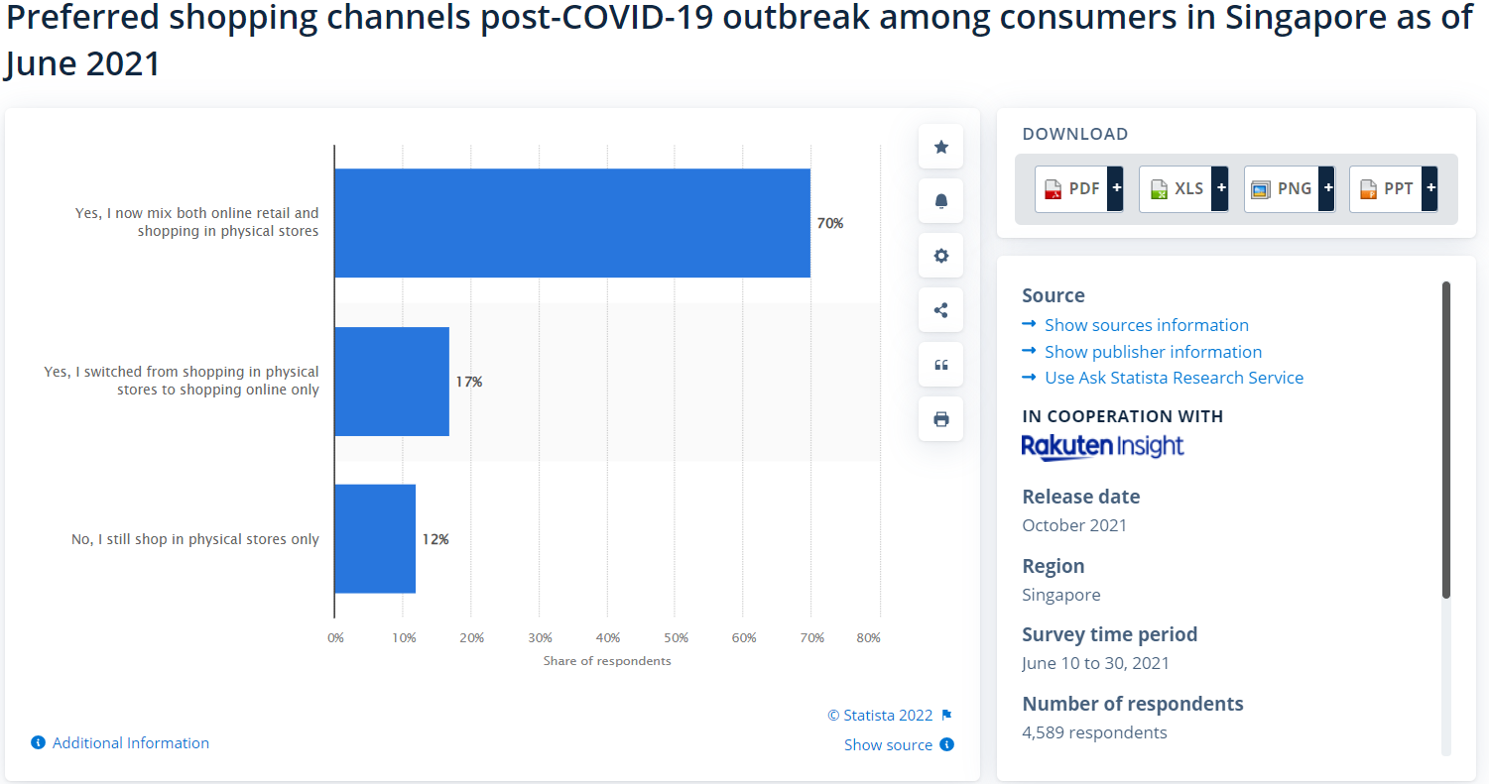
The problem: Physical Supermarket sales are under threat
Source: Statista GmbH in cooperation with Rakuten Insight, Oct 2021
Notes:
More than 87% of Singaporeans now shop online

Slide 12
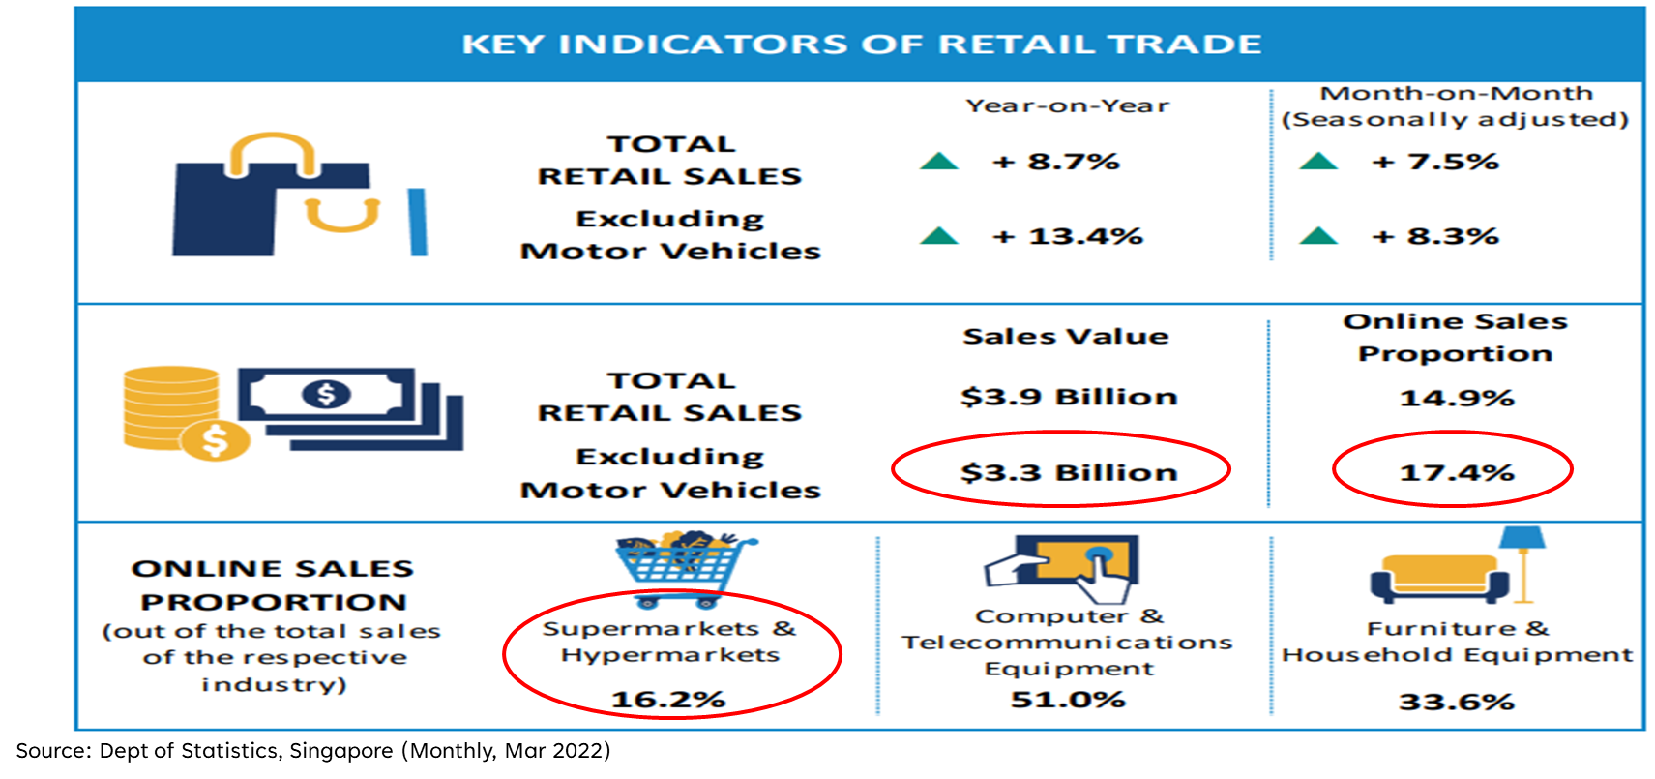
Threat #1: Ease of secured online shopping
Notes:
The number 1 threat to physical supermarket sales is the ease of online shopping.

Slide 13
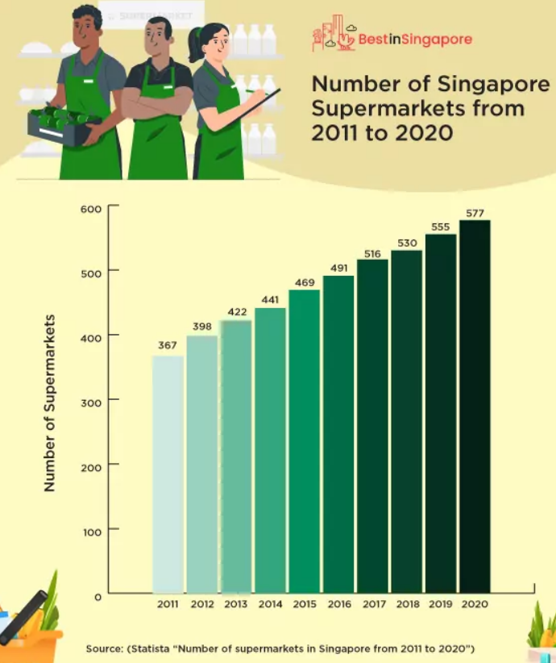
Other threats
Higher business costs (rental, salaries etc.) due to inflation
New entrants (Don Don Donki, Haomart, Prime Supermarket etc.) and more stores launched by existing players
Manpower shortages
Notes:
Other threats include higher business costs because of inflation, new entrants and new store openings and manpower shortages.

Slide 14
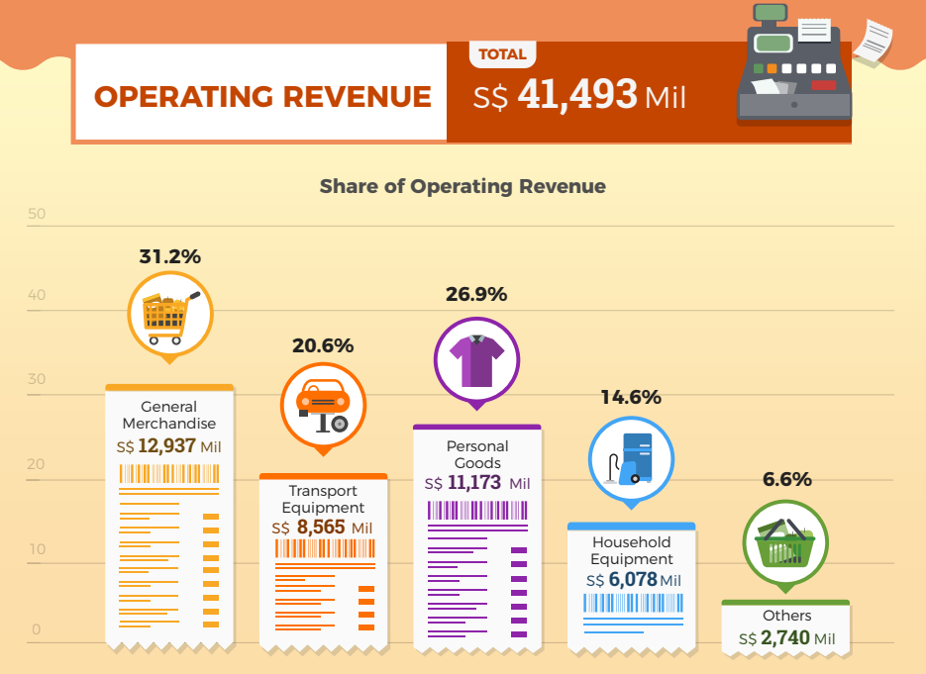

Addressable market size for supermarkets & hypermarkets
Market Size S$32.7bn
The Big 3:
NTUC, Diary Farm, Sheng Siong forms:
S$6.2bn (19% of market)
Source: Dept of Statistics, Singapore (2021)
Notes:
Based on the Singapore department of statistics, the market size for retail sales is S$32.7bn and the big 3 players, NTUC, Diary Farm and Sheng Siong only accounts for 19% of this market. So big picture, the market is still there for the taking.

Slide 15

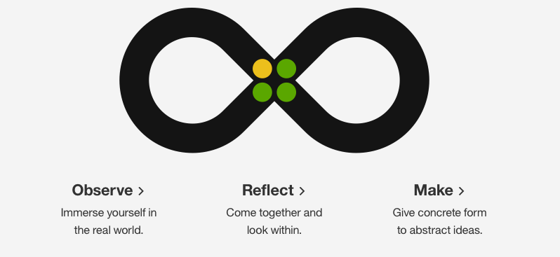
User persona
Name (Job) : Mustafa (Supermarket Outlet Retail Manager)
Work experience: 15 years, tech savvy, no kids
Motivation
Stagnating sales and lower customer footfall. Recent promotions have failed to increase sales.
Constantly works overtime because of the lack of staff, handling of routine customer FAQs, customer complaints and staff recruitment
Goals
Wants to increase store sales because bonuses are tied to store sales
Wants his team to focus on higher value tasks instead of routines
Needs
Personalise engagement with customers so that customers buy from ACE Fresh Market instead of from competitors
Ability to automate responses to routine customer queries and complaints
Notes:
However, the picture on the ground, at the individual supermarket level is very different. Lets look at our user persona, Mustafa.
Mustafa is one of 88 Ace Fresh Market retail managers. He has 15 years’ of work experience, is tech savvy, extremely busy but no kids. As you can see from a photo of him, he goes around with a pen, paper and mobile phone and writes down everything, very very hands on.
[Read from slide]

Slide 16
Pain Points
No growth in sales despite increase in marketing budget
Past ideas to increase promotions and sales have not achieved targeted outcomes
Declining customer footfall in physical stores
Flat supermarket sales and declining customer footfall
Lack of understanding of customer preferences and wants
Lack understanding of customers
Consumer brand owners starting to renegotiate reducing shelf space or reduced fees
Online sales losing out to competitors’ website
Customer service complaints regarding poor service
Long payment queues during peak shopping hours
Lack of staff to handle customers
Customer FAQs take a lot of time
High staff turnover due to being overworked
Notes:
After interviews with Mustafa, his staff and customers, we can summarise that the 3 main pain points for Mustafa are:
Flat supermarket sales and declining customer footfall. Hence, performance bonuses are affected
There is a lack of understanding of customers’ preferences and needs. As a result, marketing promotions and efforts have failed to achieve targets. A lot of effort, but no results.
Lack of staff to handle customers’ routine questions, handle customer payments and as a result, the more important stuff don’t get done
So the overall picture on the ground is not looking good. To summarise:
Lack of understanding of customers preferences and needs, results in poorly designed marketing campaigns. A lot of effort put in, but no results, no bonus.
From the staffs’ perspective, more work, put in so much more effort but salary still the same. What for? Better resign and look for better job!
For Mustafa, he is in a perpetual crisis.
Every morning, once he steps into the store, one or two staff sure report sick and that is on top of the 2 vacant staff positions which he is still hiring for.
So, besides his managerial responsibilities, he has to also cover for his missing staff.
He has good staff, he can see everyone is trying their best, but the team still cannot cope with the volume of work.
Over his lunch break, he conducts interviews to recruit for new staff. If he is lucky, he can find a suitable candidate after every 10 interviews.
At the end of another hectic day at work, one of his best staff come forward and tender her resignation – too much work and no prospect for salary increases. And so the vicious cycle continues, so despite the best intentions, so tired already, how to have kids?

Slide 17

How Might We…
Have 24/7 customer engagement
and sales
for
so that
Customers spend more money with us without increasing staff headcount
Notes:
So after various refinements, our “How might we” statement is as follows:
[Read from slide]

Slide 18
Business opportunity
Use of AI can:
Enhance our engagement with our customers’ 24/7 and personalize their experience. This will increase customer loyalty and sales
Handle routine tasks and customer FAQs in order to optimize employees’ time to handle higher value tasks
Notes:
We strongly believe that there is a good business opportunity for supermarket players to use AI as AI becomes more accessible and devices become more embedded into our customer’s lives.
[Read from slide]

Slide 19
Section 3: ai design essentials
Notes:
Section 3 – AI design essentials

Slide 20
AI INTENT
Why are we doing this and what are the big ideas that support the effort?
Enrich our interactions with our customers
Recommend products with confidence
Giving customers a reason to buy from our stores (online and offline)
Getting customers to tell us their preferences
Recommend popular food recipes and where to the ingredients from the store or website
Identify well known food dishes for customers to try
Virtual assistant
Customised promotions for individual customers
Making our customers happy with our interactions
24/7 responses to customer enquiries in real time
Partnered promotions with the consumer brand owners to target customers
Recommend common household hacks and how to get the products from the store or website
Customer feedback: Both positive and negative
Handling and monitoring customer complaints
Recommending items to buy based on customers’ stock levels held at home
Notes:
The two main AI intents of our project are:
To enrich our interactions with our customers
Recommend products with confidence to our customers because we know our customers much better
Our thoughts are on the yellow stickies which have been clustered, supporting the two main intents in blue.

Slide 21
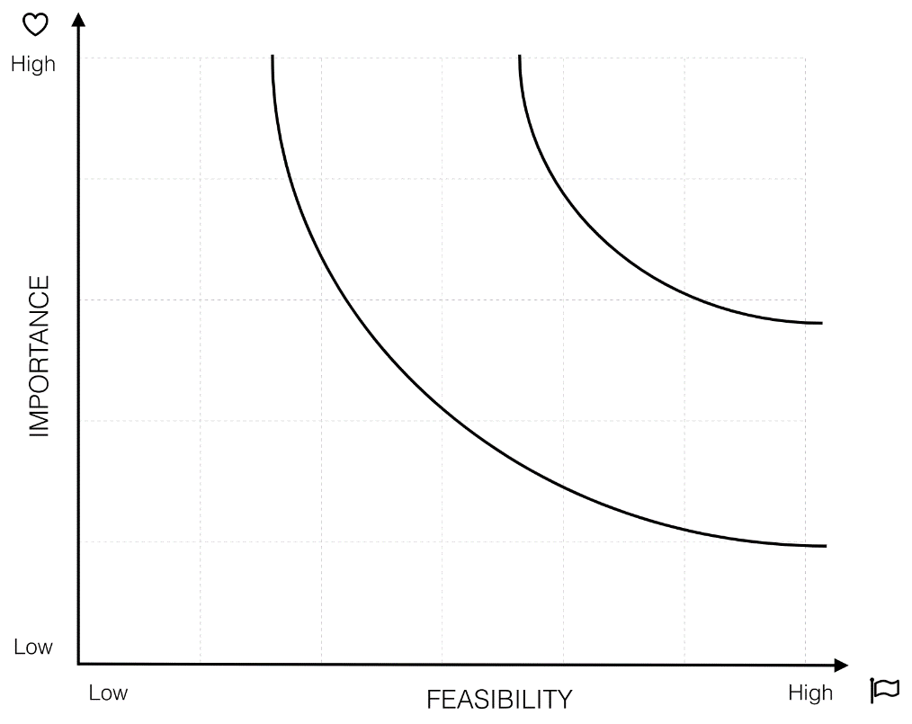
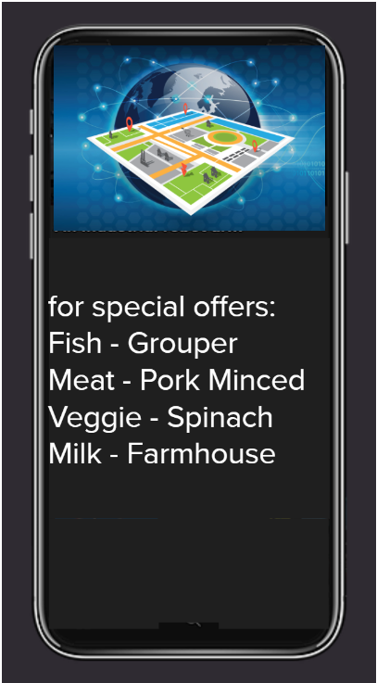
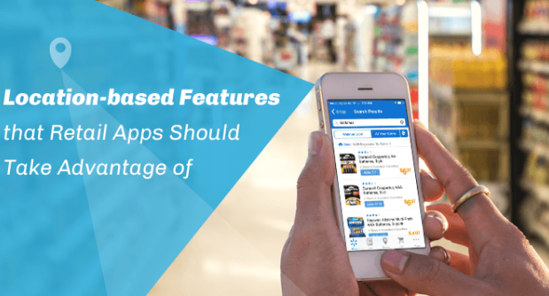
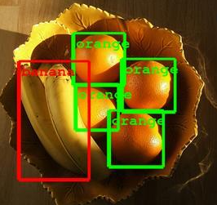
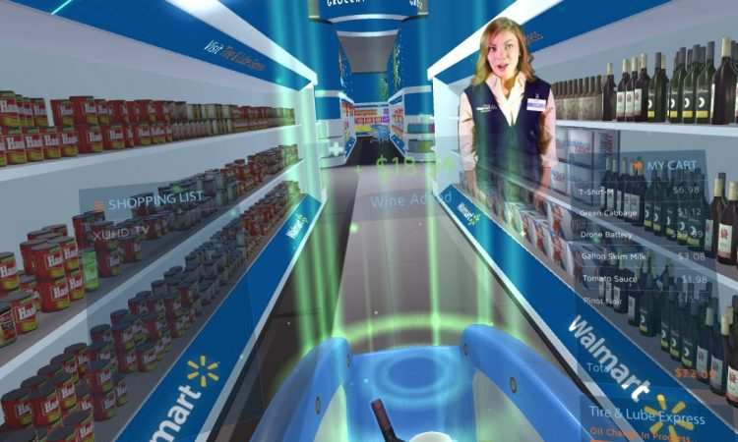

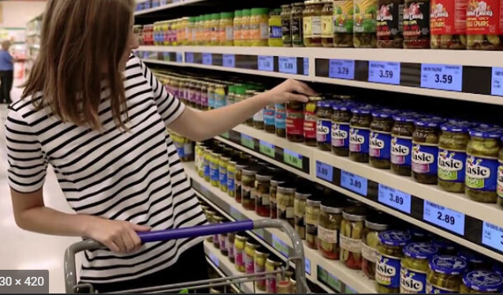
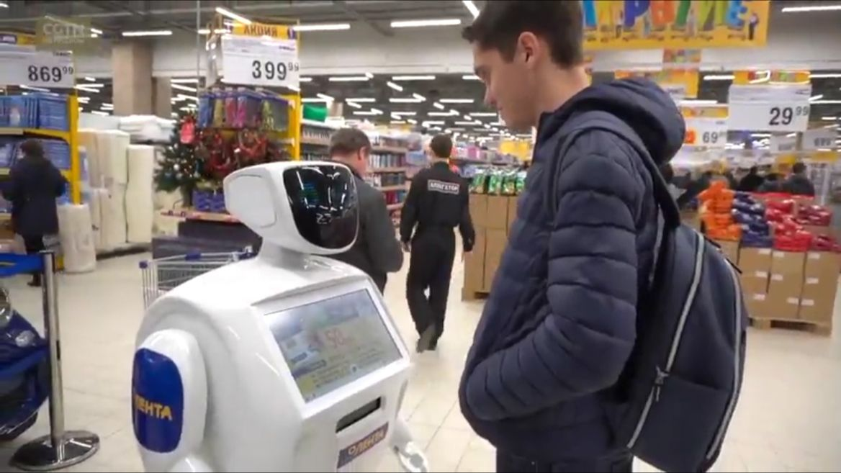
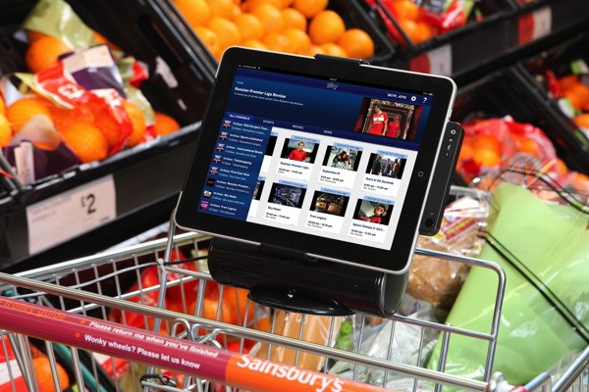
Big Bet
Object recognition / detection
No Brainers
AI driven chatbot
Hologram
Utilities
Smart Shelf
Big ideas prioritISATION grid
Robot
Auto pay trolley
Unwise for now
21
Notes:
We brainstormed for big ideas and thought of some solutions, for example, an AI robot, auto pay trolley, smart shelf, hologram and in the end, we found that an AI driven chatbot and an AI enable object recognition or object detection provides the most promising solutions to meet our two main AI intents.

Slide 22
BIG IDEA!
Enrich our interactions with our customers
Recommend products with confidence
Object recognition / detection
Giving customers a reason to buy from our stores (online and offline)
Recommend popular food recipes and how to get the ingredients from the store or website
Identify well known food dishes for customers to try
Getting customers to tell us their preferences
Virtual assistant
Customised promotions for individual customers
Making our customers happy with our interactions
24/7 responses to customer enquiries in real time
Partnered promotions with the consumer brand owners to target customers
AI driven chatbot
Recommend common household hacks and how to get the products from the store or website
Customer feedback: Both positive and negative
Handling and monitoring customer complaints
Recommending items to buy based on customers’ stock levels held at home
22
Notes:
We matched our potential solution to the intents and got this.
An AI driven chatbot can:
Provide 24/7 responses to customer enquiries in real time
Collect customer feedback, both positive and negative
Handle and monitor customer complaints
Make our customers happy with our interactions, maybe even tell a joke
In the end, giving customers a reason to buy from our stores, both online and offline
An AI driven object recognition or detection service can:
Identify well known dishes for customers to try
Recommend popular food recipes and making it super easy for them to get the ingredients from the store or website
Get the customers to tell us their preferences, so that we can sell what they want!
Of course, there are many other ideas we can work on, for example targeting other common household items, linking their home inventories to us, partnering promotions, but we decided to first focus on favourite foods, because firstly that’s what we all like and need and secondly, in a food recipe, you have many ingredients, so after selling one dream, you sell many ingredients and items for the supermarket.
Say Chao will tell you more about the future iterations and MVPs towards the end of our presentation.

Slide 23
DATA
What data could bring your ideas to life?
 | Public | Private | User (customer)
Have | Geolocation data of each store Popular Singapore foods | Product list and prices Location of products in the store and inventory levels Past customer feedback Customer traffic (footfall) and peak shopping hours in our stores Proportion of online and physical sales | Aggregated volume and value of items purchased from stores (online and offline) Note: No need to identify customer as data is collected on an anonymized basis (except for customer feedback)
Want / need | Pictures of selected foods Good food recipes Ingredients list on each food recipe | Customer demographic profiles Marketing priorities of the consumer brand owners | Why customers shop with us? Individual customers’ purchase preferences/ habits Current customer feedback/ views/suggestions
Nice to have | Income levels of population living within 2km from the store | Product correlations (how likely a customer would buy a second product if the first product is bought) | Customer’s past purchases Individual customer “wallet size”
Note: Data in Red is used in MVP 1.0. The rest of the other data will be used in future iterations.
Notes:
We then brainstormed on what type of data we have, want or need and nice to have and categorised them into public, private and user data on this grid.
[Read from slide]
The data marked in red are those that was used in our MVP version 1 and the remaining data will be used in our future iterations.

Slide 24
UNDERSTANDING
What will a machine need to understand from this data so it can reason?
Object recognition / detection
AI driven chatbot
Pictures of popular Singapore food dishes correctly labelled
Deep learning algorithms to learn from data fed into the model
Links to Wikipedia and DB2
Embed with the chatbot
Natural language processing
Common intents for example looking for food recipes, information on the business, receiving feedback etc
Dialogs to appropriately respond to the intents
Links to Wikipedia
Integration with the model and website
Notes:
We then asked ourselves what will a machine need to understand from this data so that it can reason?
[Read from slide]

Slide 25
REASONING STATEMENT
How will a machine apply logic to what it knows?
Can
Enrich our customers’ shopping experience with us
By
Helping customers identify food they like, food recipes and buy these ingredients
Based on
Deep learning model prediction of our customers’ uploaded favourite food pictures
Chatbot to delight our customers’ interaction with us and making it super easy to order these ingredients
Notes:
Summarising all the above, our reasoning statement is as follows:
[Read from slide]

Slide 26
KNOWLEDGE / AI ethics
If you succeed, what are the implications of what your AI will know?
Primary
(Intended and Known)
Can identify popular food dishes and recipes for customers
Based on known customers’ food preferences, able to anticipate what are the ingredients that customers will likely buy
Know what items customers are looking through customer queries to guide future store design and promotions
Recommendations to purchase specific ingredients may be bias
Know customers’ feedback about the supermarket (positive and negative) for follow up action
Know customer demand for specific ingredient items to launch joint promotions with consumer brand owners
Recommendations could affect the eating habits and buying patterns of customers
Know customers better to launch joint promotions with credit card companies
Secondary
(Intended and Known)
Recommendations will also affect the demand on other food products and consequently, the other consumer brand owners
Tertiary
(Unintended and possibly known)
Notes:
We then identified what are the implications for us and our customers if this works?
The primary implications are:
We can identify popular food dishes and recipes for our customers
Based on their preferences, we can anticipate what ingredients and items they would want to buy from the store
We will know what our customers think of us 24/7, so that we can take quick remedial actions to improve and better our service offerings
The secondary implications are:
Because we know what customers are looking for or have difficulty looking for, we know better how to guide future store design and promotions
Because we can anticipate what our customers will want to buy, we can work with consumer brand owners or credit card companies to launch joint promotions
The tertiary implications are:
Our recommendations to purchase specific ingredients may be bias
Our recommendations could affect the eating habits and buying patterns of our customers. Imagine our customers eating chicken rice everyday
Our recommendations could also affect the demand for other food products and consequently the other brand owners who are also our supermarket customers
So that’s the background how we come to developing our AI product and I can’t wait to let Say Chao show our AI solution to you. Over to you, Say Chao!

Slide 27
Section 4: demo of our ai product
Notes:
Thank you Eugene for the insightful explanation on the project background.
Before moving forward, my team and I wish to provide a demo on our Product so that it is more easier to infer as we introduce our later section.

Slide 28
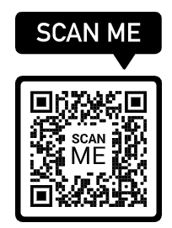
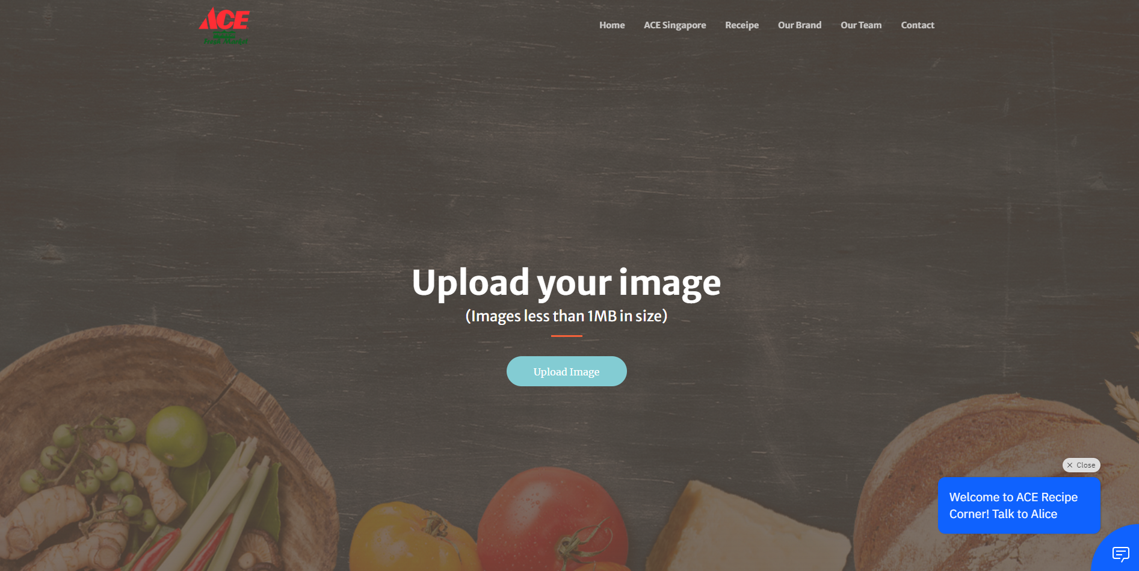
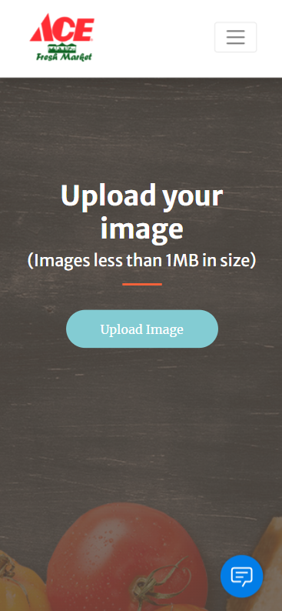
Our PRODUCT (Responsive Hybrid Website)
Work in both Web (using PC) and mobile browser (using iPhone Safari, Android Chrome etc)
OR enter the URL: https://myfoodclassify.herokuapp.com
Web Browser
Mobile Browser
Notes:
Customer of the supermarket can launch our website
from the supermarket ecommerce website
or
scan the QR code to launch our website if they happen to be at the store.
You may wish to scan on the QR code shown on the screen or type the URL in your browser to launch our website.
[click]
Our website is a Responsive Hybrid Website, which mean, it work both on the Web in your PC or browser on your mobile device.
Without further delay, I will now proceed with the demo
Launching the URL will bring the customer to the homepage, where they can perform the following action
Upload the image of the food that they are interested to view the food details, like the ingredient and recipe
Or
Scrolling downward, they can see information of the supermarket and their store location (click on store will bring up a google map showing the store location)
Or
They can scroll down some more to see the list of food recipe available (click on the food and the App will show the detail of the recipe, I will demo click on the food later on, do not click)
Or
Scroll down some more, the customer will be able to see our affiliated Foods and Brands associated . (Click on the foods will show the Brands)
or
scroll down, customer will see the team member supporting the Website that it happens which make their live better
and finally,
the last section is where customer can submit their feedback to us (enter name, email and feedback)
As I mentioned earlier, the Website will work in mobile as well, so this is the mobile view of the website
Now I will upload an image (a picture of nasi lemak) for prediction. Once I upload, the website will send the image for prediction and display the relevant details
So in this result page, customer will
see the predicted result (which is the nasi lemak)
and
the uploaded image of the nasi lemak
We use the predicted result which is the nasi lemak and get the wiki content, so that the customer have a understanding of the food they have uploaded
In the result page, you see that there is 2 buttons: ingredient and recipe
When customer click on the ingredient button, the website will show the list of ingredients required for the food.
Customer can select the ingredient required and submit to the supermarket ecommerce website to do a direct ordering
Customer can choose to download the ingredient for later reference
When customer click on the recipe button, the website will show a step by step guide on how to cook the food. Customer can download the recipe as well
For those customer who wish to browse food recipe like Char Kway Teow, they can click on the food image, and the website will show them the content and the respective ingredient and recipe
We have a chatbot embedded in our app so that the customer can perform self-help if there is any question
Thus, Welcome to Ace Recipe corner and talk to our dear chatbot Alice
After opening the chatbot, customer will be present with 3 default selection to guide them. Customer can also type “Hi” to begin
Chatbot will ask for the Customer name to address the customer along the conversation
So customer will type in their name “XXX” and chatbot will reply a greeting message
Assume Customer ask for the company detail by typing “tell me about your company”, the chatbot will reply the supermarket information
Moving on, if the customer want to know more about foods and type “Singapore foods”, then the chatbot will present a few selection.
Let say customer chosen “Nasi Lemak”, then system will present the Nasi Lemak content from wiki and also display an image of nasi lemak as well
Chatbot will prompt if the customer is interested in the recipe.
Assume customer choose “Yes”, then chatbot to display the step by step guide on how to cook the nasi lemak well
Chatbot will carry on to prompt if customer want to see the ingredient of the nasi lemak as the supermarket wish the customer to buy the ingredient from them to further improve the store sales
Let say customer chosen “Yes”, then chatbot will display the ingredient required to cook Nasi Lemak
Chatbot will follow thru to engage the customer to prompt them Buy online or Buy from the store.
Both option will direct the customer to our Website
Click the link “on-line store”, user will be directed to our on-line purchase webpage
User can check those ingredient required and make their submission
Now if the customer wish to see the “recipe of Char Kway Teow”, they will enter in the chat dialog and chatbot will display the char kway teow recipe straight away
Custom can also enter “ingredient of Char Kway Teow”, for the chatbot to show them the ingredient of char kway teow
When “ingredient” was mentioned, chatbot will always try to engage the customer to buy the ingredient from the supermarket
By clicking on “Buy from store”, the chatbot will show a link
Click the “web site”, the user will be directed to webpage to download the information
if customer just want to know what is the dish information and what does the dish look like, they can type “tell me about laksa”. Chatbot will link up to wiki and display the content and image from wiki
Click the “home” icon
We had design the chatbot in such a way that we want the customer to feel relaxed using it, so we engaged the customer thru joke as well
Customer can click on “Hear a Joke”
Embed in the joke are some products information that make customer aware what the supermarket are selling and the location of these item.
We thought this might upsales some of the products to increase sales for the supermarket
Typing “joke” to will also trigger the same mechanic
For customer who like to leave us feedback, on the greeting page, they can click on the feedback button
Click the “feedback”
Click the “feedback form”, then the user will be directed to webpage feedback area.
If Customer type words like “good job” or “not so good” in our chatbot, then Chatbot will recognise that customer might want to leave some feedback and will request customer to fill up the feedback form too
If chatbot detect that user wants to talk to a human agent, for example “I want to talk to your manager” or “Get me your manager”, then chatbot will provide a number for the customer to engage with our customer service executive instead
To end the conversation, customer type word like “bye” or “see you”, chatbot will response with a endnote
So this come to the end of our demo
Next I will touch base on our project planning and design consideration

Slide 29
Section 5: Project planning and design

Slide 30
PROJECT PLANNING AND TIMELINE
Notes:
On the project planning, we start off with having a draft of our overall project timeline so that all the us know if we are on track or behind time
We list the tasks that we are required to do and also the expected duration of each task
With the estimated timeline, we define the project , filling up our EDT and AI Intent, that we will be taking on and list the requirement that we will need like the
1. What are the data we want and where we could find them
2. Model accuracy that we target to achieve
3. Draft of the chatbot flow
4. How the website look like
With these steps, everyone in the team have a clear expectation what is the end result (output) we will end up with
We also plan in the estimated cut off date for the technical side of the project so that we can start on the presentation slide as well as the dry run.
With everything coming together as we had planned out, that is how we end at where we are and what we have today

Slide 31
TECHNICAL PLANNING AND CONSIDERATIONS
Tools required | What we use | Alternatives | Reasons
Notebook Environment | Kaggle Had a lot of datasets which we use directly Notebook can be made public and easier share with team member to view or fork Remember the execution result so that it is not required to execute each time your session end | Colab Colab is slightly faster using TPUs rather than GPUs to share notebook, need to download and send to team member Session have to keep active to retain the execution result | Can easily share and fork the latest code from our team member Notebook is easily retrieve and reference to previous execution result while doing hyperparameter optimization
Deep Learning Framework | Keras Easy to build, training and evaluate the model quickly Have plenty of learning resource online | PyTorch Offer better debugging capabilities Used by more experienced data scientist as it is more versatile | Chose Keras since it is best when working with small dataset and rapid model development And it can comparative simple yet can fulfil our requirement
Notes:
Before we dive in to develop the technical part of the project, we did some technical planning on the tools we can use and why we use them
Here are the list that we had consolidate:
We understand that we need to use python for the model training and development, thus we search for the environment available and we got Kaggle and Colab.
Kaggle have lot of dataset and is easier to collaborate, although Colab is faster, but it is harder to share code in Colab, thus we chose Kaggle as our notebook environment for python development
Since we are working on image recognition, so we have to have deep learning to train the model. therefore we are selecting Keras against PyTorch
Keras is easier to build and train and can already fulfil our requirement and have plenty of online help over PyTorch, withl most probably are for the more experience scientist.

Slide 32
TECHNICAL PLANNING AND CONSIDERATIONS
Tools required | What we use | Alternatives | Reasons
Web Framework | Flask Easy to use Explicit, that make it easy to read Written in Python Lightweight, quick to start. Compatible with latest libraries | Django Full-Stack framework Used for complex and large projects Rapid prototyping Written in Python Scalable and Portable | Extensive documentation Lightweight Full control over the development process
Cloud Database | IBM DB2 Able to pull data effortlessly via API Support wider range of languages and OS than Azure | Microsoft Azure SQL Transact SQL Less expensive | Already have an IBM lite account Azure SQL has a high barrier to entry. (to register to sign up for a limited 1 year trial version)
Notes:
As we are delivering a website, so we will need a web framework to render the HTML page and their javascript. Thus we compare Flask and Django.
We found that flask is easier to code and can render a HTML page with 2-3 line of codes and it can compile in a shorter time, thus will make our debugging process less intensive. Django being a full stack framework is much slower, thus we avoid using it
A website will always be support by database for CRUD operation (Create, Retrieval, Update & Delete) on the data in action We were choosing between IBM DB 2 and Microsoft Azure SQL.
Both DB required to code using their respective connector and sign up account. We choose IBM DB 2 since we already have an account which we can start off with

Slide 33
TECHNICAL PLANNING AND CONSIDERATIONS
Tools required | What we use | Alternatives | Reasons
Version control and Repository | Github Extensive documentation Markdown simple text editor Good for backup Limited at 25mb web upload and cannot exceed 100mb on a file. | Gitlab Allows RBAC controls Have import/ Export Repo function with time stamp. Community not as big as Github Sower interface | Allows easier collaboration and setup files with Github Desktop Fast upload / download of files with good documentation of changes to ensure latest version Good community for questions
Web Server | Heroku Agile deployment for Ruby, Node.js, Clojure, Java, Python, Go and Scala Run and scale any type of app. Able to connect to Github | IBM Cloud Foundry Phasing out June 2023 Small community and hence, lack of documentation. Support is lacking | Better documentation Able to connect effortlessly to GitHub Larger File Size 500Mb deployment
Notes:
As we develop our code, we will also need a repository to keep versioning of our codes so that we can rollback if there is any issue on working version. We were choosing between GitHub and Gitlab
GitHub as we try out, it is easier to share and fork files with team member and its community support is large than GitLab, thus we chosen to work with GitHub
We will need a web server to host the files to the public users and was choosing between Heroku and IBM Cloud Foundry
We noticed that Heroku already has a direct connection to GitHub and can compile, build and deploy Github code as a App in Heroku. IBM Cloud Foundry is going to be deprecated end of this year and will be phrasing our mid of 2023, so we choose to go with Heroku for our web hosting

Slide 34
TECHNICAL PLANNING AND CONSIDERATIONS
Tools required | What we use | Alternatives | Reasons
ChatBot | IBM Watson Assistant Easy build of a chatbot with step by step process guidance Allow testing of bot to speed up development time Has a lot of documentation online | Dialogflow Simple solution for chatbots which is fast to build Great user interface for creating the chatbot Possible to create extensive dialog tree | Chosen Watson Assistant as our team have prior experience Know those functionalities that we want are present in Watson Assistant Am sure that the chatbot can be easily embed in our website
Notes:
For the chatbot, we are comparing IBM Watson Assistant with Dialogflow.
We go ahead with IBM Watson Assistant as we have prior experience building it, thus it would speed up our development and we also knew that Watson Assistant have the functionalities to fulfil our needs. Also we can embed Watson Assistant with a few lines of javascriptin our HTML files

Slide 35
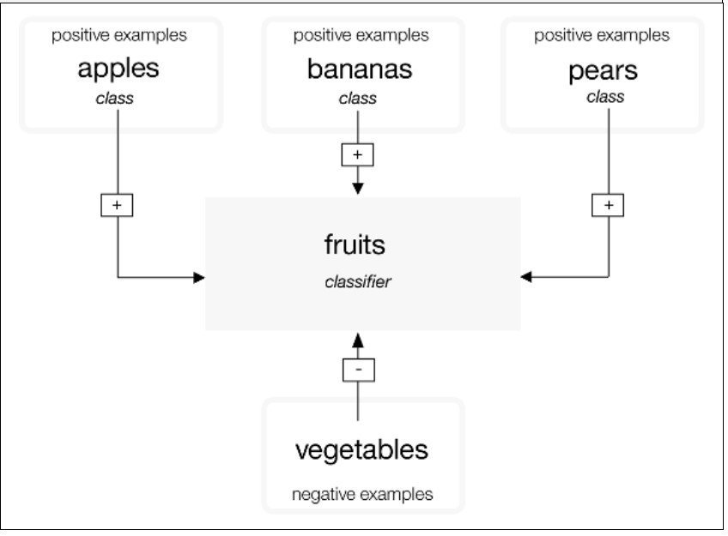
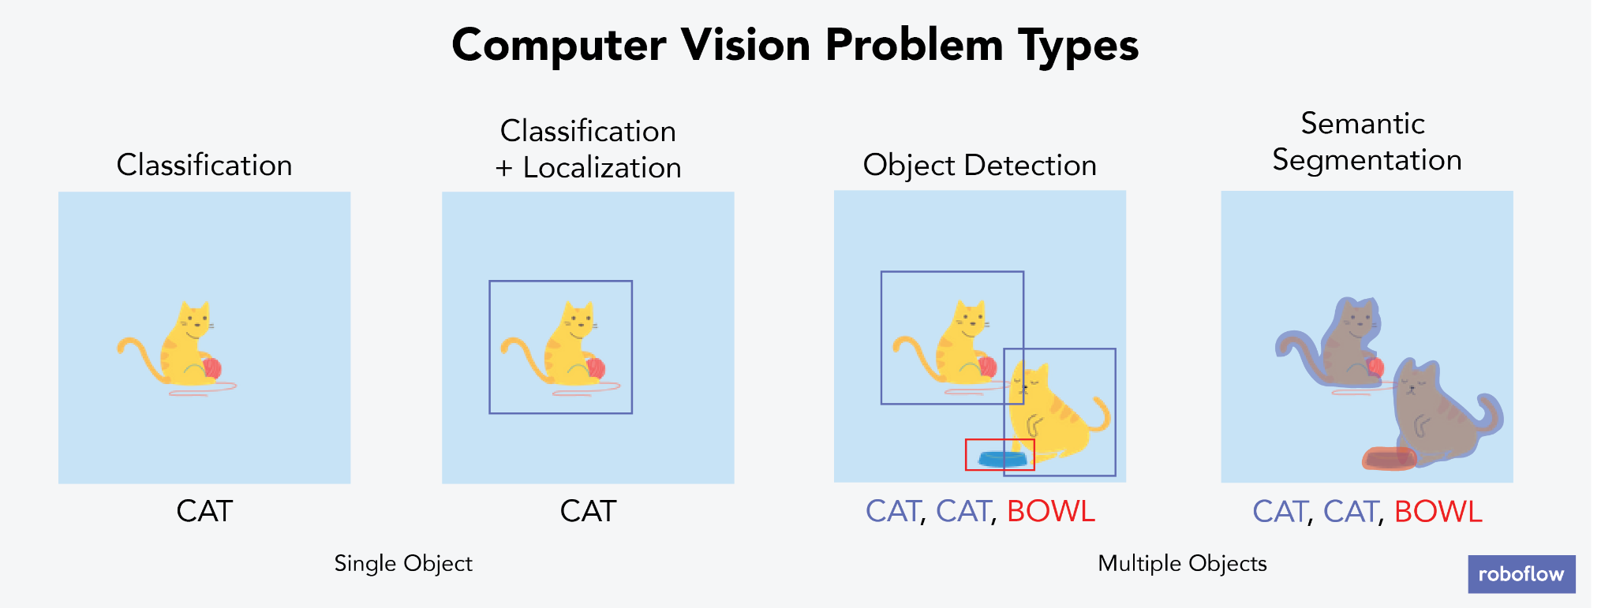

Model CONSIDERATIONS
Issues | Solution
1. Model selection Binary or multi-class classification | Split the project into different phrases Working with 2 classes of object Start small to roll out fast to obtain feedback for continuous improvement
2. Hyperparameters optimization (Keras) Filters (e.g. 8, 16, 31) Kernal_size (e.g. 1x1, 3x3) Size of image (e.g. 32x32, 64x64) Hidden Layer (e.g. single dense, 2 dense) Activation function (e.g. relu, sigmoid) | Adjusted some of the hyperparameters that we used to refine our model Detailed of the Hyperparameters will be further elaborate later on section 6
BINARY IMAGE CLASSIFICATION
MULTI-CLASS IMAGE CLASSIFICATION
VS
CAT or DOG?
Notes:
On the Model Consideration:
We were choosing between a binary image classification or a multi-class image classification model. In the later model, we can put in the negative image but it would take a bulk of time as we will need to gather a huge dataset of negative image to train them. Training will also consume a considerable time. Thus we decide to start small and roll out fast to gain customer awareness and feedback , then continuous enhancing our Website and Model as we move along the different phrase
Since we have chosen to use Keras for the deep learning, we dive into the hyperparameters that we can used to refine our model to achieve our target accuracy (90%). These are the four parameters identified, which are
Filters
Kernal size
Size of Image
Hidden Layer
And activation function
Colin will further elaborate the detail on the later section

Slide 36
Website development CONSIDERATIONS
Issues | Solution
1. Slow compile and deploy by Heroku and GitHub integration Each build took around 5 min, inefficient for debugging | Install Python in local machine to execute app.py to host our website for development
2. Not able to route to index.html and predict.html like our usual website E.g. http://url/index.html or http://url/predict.html | Understand that Flask framework require the server code to render the page to be accessible
3. Not able to reference to Javascript, CSS files or display images files on the page E.g. “./js/index.js” or “./css/index.css” | Understand that Flask framework required a static folder to keep those files and use its {{ url_for('static',filename='') }} syntax to reference the files
Notes:
For the Website Development Consideration
We noticed that although Heroku and Github have straight forward connection and can build and deploy easily, it is too slow. Taking 5 min at each iteration. This is very inefficient for debugging and troubleshooting
So we decided to install python and its required library locally on our PC and use it to execute app.py to host our website as we develop and debug thru the codes
We try to route the different HTML page as like we did in a usual website, we notice that the website gave a reply 404 file not found. We re-study the flask web framework and finally understand that flask require the server side code to render the page to make it accessible
We created our own javascript and css files and tried referencing to those fiels. In Flask framework, a static folder is required to reference to these files

Slide 37







Development to DEPLOYMENT Overview
Heroku
Github
Local Environment
LIVE
DEVELOPMENT
GitHub Desktop is an application that enables you to interact with GitHub using a GUI instead of a web browser
Desktop version of GitHub allow upload up to 100Mb per file
Github Desktop
Sync files to GitHub
Copy files for deployment
Compile &
Deploy App to Heroku
Kaggle
Edit and troubleshoot python code
Web Server
Repository
Python
Compile & Execute app.py
Notepad++
Notepad++ is a text and source code editor.
Notepad++ was used in our development of the HTML, css and JavaScript file.
Chrome Browser
Launch index.html @ http://localhost:8080
Test and Debug HTML, JS and CSS code
Notes:
This is an overview of our development to deployment environment which we mentioned earlier which help us save plenty of time instead of waiting for each iteration of the build by Heroku and Github
[click]
Heroku and GitHub remain as the Web Hosting Server and Code repository for the live environment
[click]
In the development environment, we use Kaggle to troubleshoot our python code, and notepad++ to edit our HTML, JS and Css code. Python to execute the app.py code and launching the browse in localhost to test and debug the code
Once we are satisfy with a build, we will use GitHub Desktop to sync our file to GitHub. Github Desktop support upload up to 100MB instead of the web version which limit at 25MB

Slide 38












Libraries to support the Website
Render HTML
Flask
JavaScript development
jquery
Load Model
Model Prediction
Keras
Our website presentation layer are coded in HTML with CSS supporting its layout theme and JavaScript to control what is display on screen under its respective circumstance
Layout Styling
Bootstrap 4.0
Read Image
Matplotlib
Google Font
Layout Font
Python
Resize Image
Scikit-Image
HTML, JavaScript, Css
Layout Formatting
Simple Lightbox
Manage Array of Predicted Result
Sort Array
Numpy
Popup Dialog
Keep Data for storage and retrieval
Sweetalert 2
IBM DB2
Notes:
Here are the libraries that are use to support the development of the website
On the server side, for python, we have
Flask to render the HTML, JS and CSS
Keras to load the model and model prediction
Matplotlib to read the image being uploaded
Scikit-Image to resize the image
Numpy to manage the Predicted result array
IBM DB2 which we used to keep some of our data
On the client side, for the HTML, JS and CSS, we used
Jquery for javascript development
Bootstrap, Google Font and Lightbox for Layout and formatting
Sweetalert for pop up dialog

Slide 39









Overall implementation overview
FRONTEND
BACKEND
User Devices
Browser
Internet
Heroku
IBM Services
Other Services
JavaScript
Integration
Watson
Assistant
Take Pictures
CRUD
Operation
Supported both Web and Mobile View
DB2
Web Server
powered by Python
API
Integration
Upload Images
Wiki
Using Flask web Framework
Notes:
Implementation overview
This diagram show the overview of our implementation, or in another word, this is the infrastructure involved to make the website functional
[click]
On the frontend, User can access the website using a PC via web browser or Mobile device using mobile browser and the website will render and land at the home page
[click]
At the backend, we have the webserver, linked up to Watson Assistant, IBM DB2 and Wiki
With the Project planning and technical consideration in place, we proceed with the model, website design, implementation and deployment. Colin will give a detail account of what we had done next
Colin Please.

Slide 40
Section 6: MODEL and website design, implementation and deployment
Notes:
Thank you Say Chao for the demonstration and it’s concise explanation. I will now guide you through the Model/Website’s design, implementation and deployment phase.

Slide 41
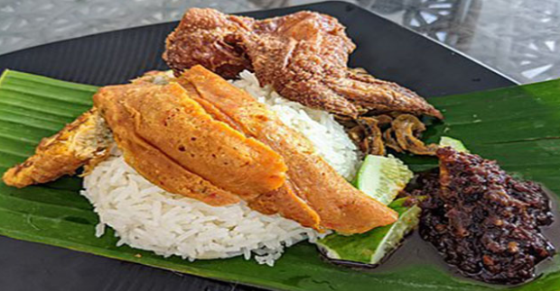


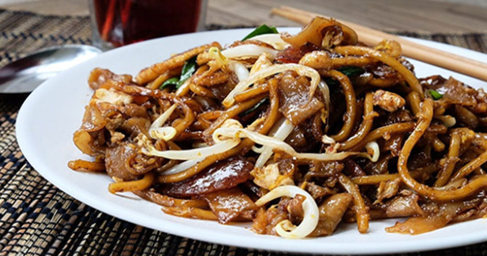

OVERVIEW OF APPLICATION FLOW
Browser
Heroku
Browser
index.html
app.py
Take in uploaded image and send it to model for prediction and return the result to predict.html
Method 1
Our Landing page.
Where we can upload image and displays information content
Upload image in index.html
predict.html
Display the result and content with additional functionalities which user can perform
Method 2
index.html
On the main page, Under the RECIPE portion.
app.py
Click content image in index.html
Take in saved image and send it to model for prediction and return the result to predict.html
Notes:
This chart shows how our application flows. There are 2 method to derive the prediction of the image.
Both of which starts from the landing page.
Method 1 –
On the browser portion, shows the landing page. The page where we see when we open the address. As Say Chao has shown, we can upload the image on that page. Once the image has been uploaded, it will be processed within the app.py in Heroku, with the results sent to the predict.html page. This is the first method of deriving the prediction in our page.
Method 2 –
On the second method, we click on either image under the “Recipe” heading. It will send the image to the app.py and onward to the predict.html page.
The main difference between two methods are
The first Method is user-own image
The second Method is predefined image from the store’s recipes.

Slide 42
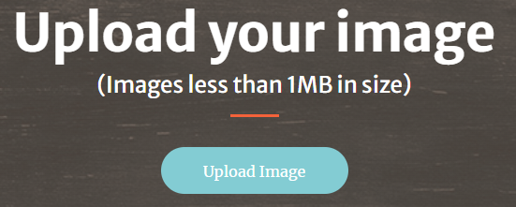
APPLICATION FLOW DETAILS –FLASK FRAMEWORK (Method 1: POST, PREDICTION)
Browser
Heroku
Browser
Method 1
index.html
app.py
As the website starts, python import Flask Library and executed default route “/”, causing the main_page() function in app.py to render the index.html.
The function then waits for a POST action.
At the user browses, the website will display the welcome page with a button for user to upload image of food
POST action
PREDICTION function
From the Json Object,
We extract and display the predicted result text.
Extract uploaded image filename, reference the filename to the image in the “uploads” folder and display the image
Use the predicted result and perform a Wiki API via AJAX to fetch the content description and display the content.
Flask request the image from the browser and save it in “static/uploads” folder.
Flask then redirect to prediction() function giving it the filename.
Keras load the trained model.
Matplotlib read the filename from upload folder to get the uploaded image
Scikit-image resize the image to the same size as what we had configured for the training
Use the model loaded and run prediction on the uploaded image
Store the predicted probabilities in array and sort them ascending order.
It then assigns the result in a json object to predict.html.
User click “upload” button and uploads an image file and submits it.
The HTML input file control send the file with a POST action
Notes:
I will now discuss Method 1 in detail.
To allow the python application to work with HTML, we use a microwebframework known as flask. Flash allows python libraries to be used with HTML.
Read from Point 1 to 17
Additional only
Flask is used for developing web applications using python, implemented on Werkzeug and Jinja2. Flask is a web framework. What this means is that flask provides you with tools, libraries and technologies that allow you to build a web application. Easy since you can build a web application quickly using only a single Python file.
Werkzeug
Werkzeug is a WSGI toolkit that implements requests, response objects, and utility functions. This enables a web frame to be built on it. The Flask framework uses Werkzeg as one of its bases.
jinja2
jinja2 is a popular template engine for Python.A web template system combines a template with a specific data source to render a dynamic web page. Allows you to pass Python variables into HTML templates.
In the above example, you called the function render_template(). Why call this method and not return html data immediately?
Flask is bundled with a language named Jinja2. This gives you the power to include variables, create loops and add if statements right in the template.

Slide 43
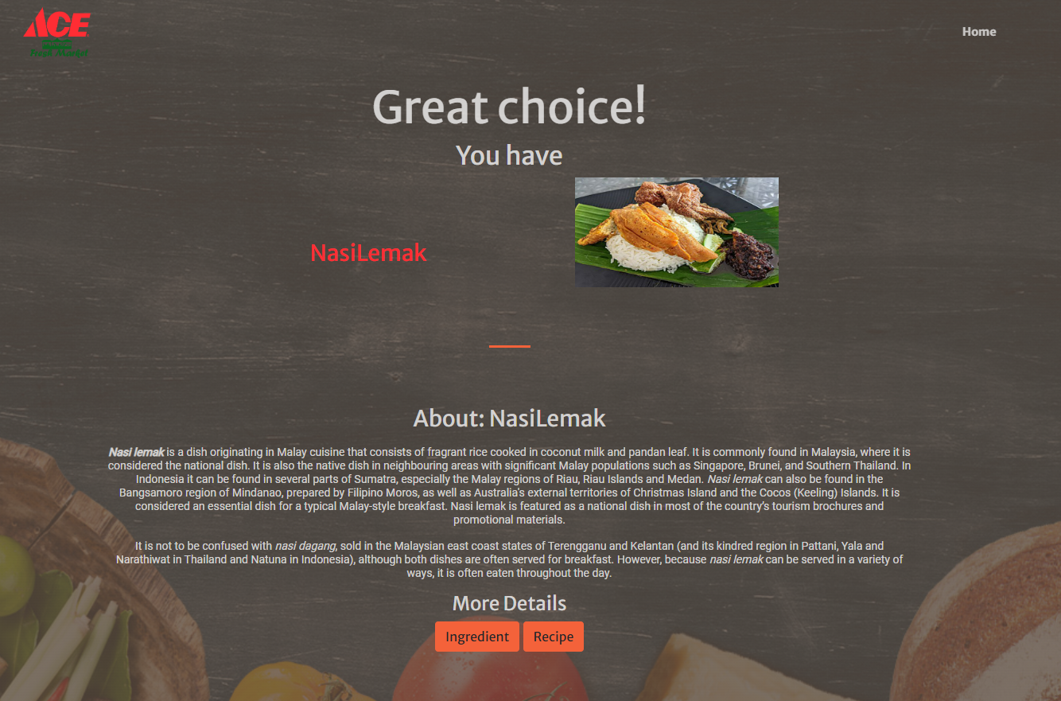
APPLICATION FLOW DETAILS –FLASK FRAMEWORK (Method 1: POST, PREDICTION)
Method 1
Browser
1. Uploaded Image
2. Predicted Result
Call getIngredient() function passing over the predicted result to obtain the ingredient detail. getIngredient() function connect to IBM DB2 database and make a SELECT to obtain the detail related to the predicted result
Iterate the JSON object and build a HTML table and append in predict.html for display
Repeat step 18 and 19 by calling getrecipe() function to obtain the recipe content based on the predicted result
Display the Ingredient Button and Recipe Button
3. Wiki Content
4. Button
Notes:
What we see in this slide for Numbers 1 to 3 are codes initiated from the previous slide.
For Item 4: BUTTON , to initialize them we (READ Point 16)

Slide 44
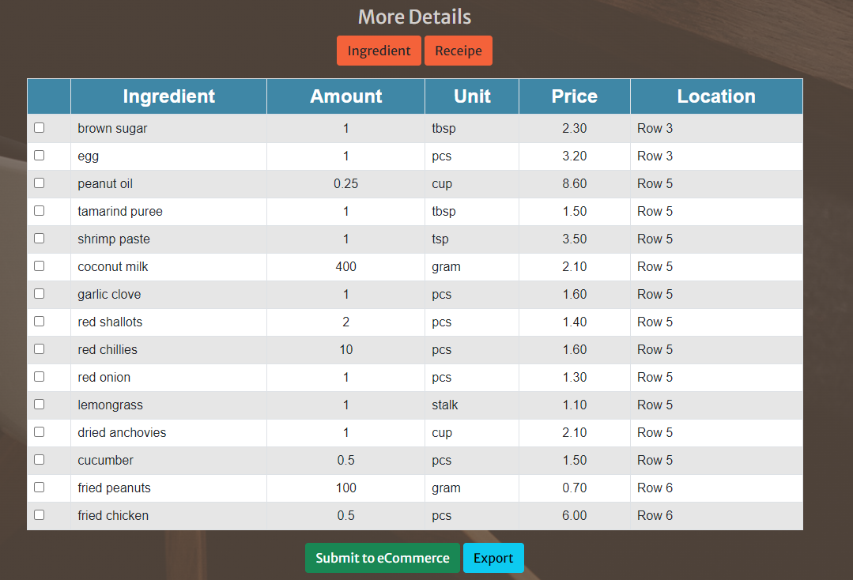
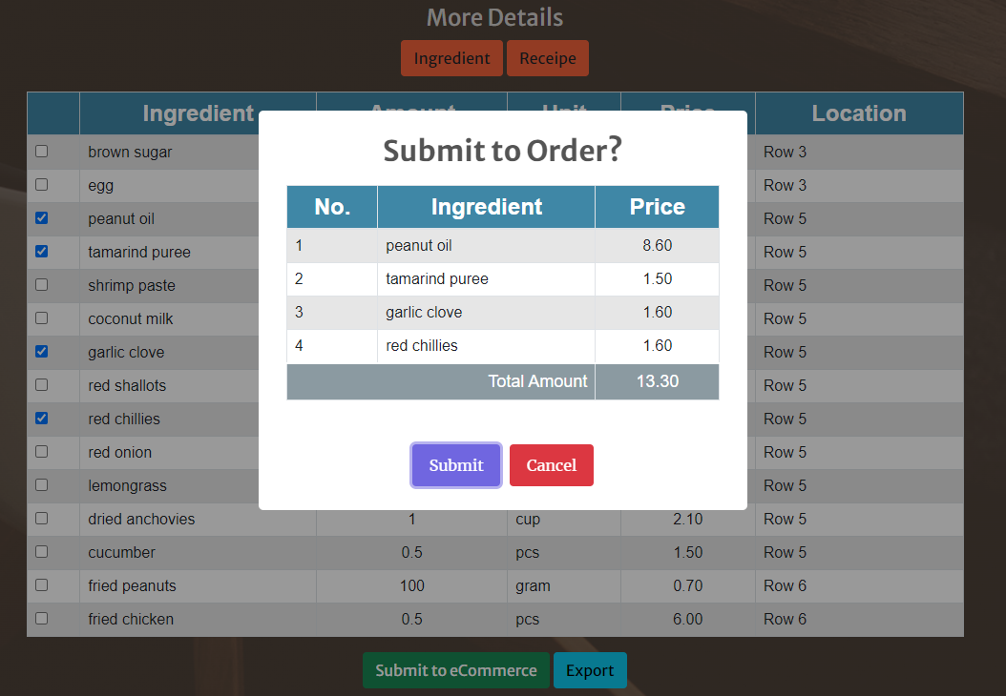
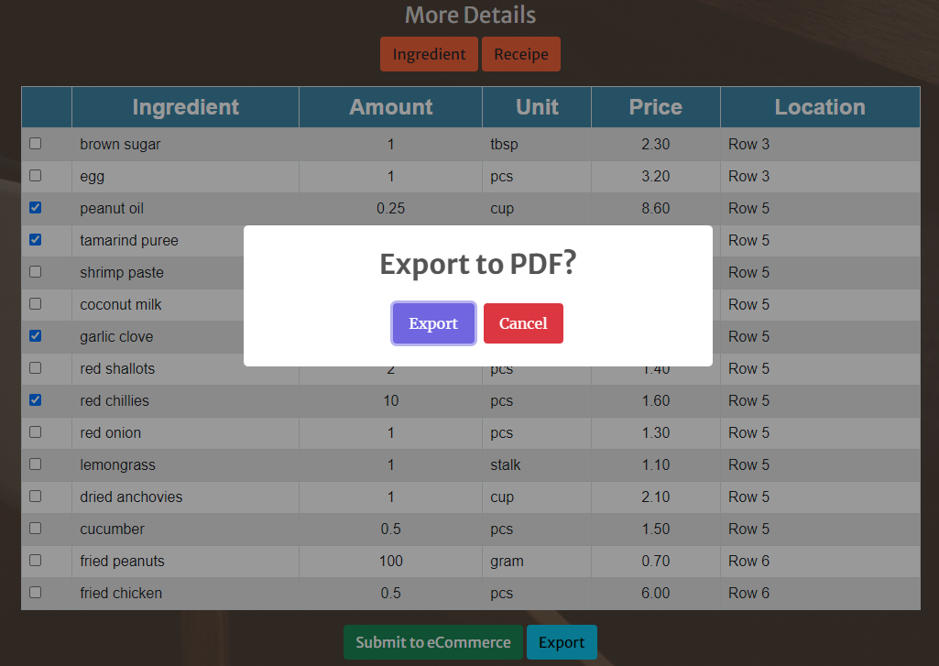
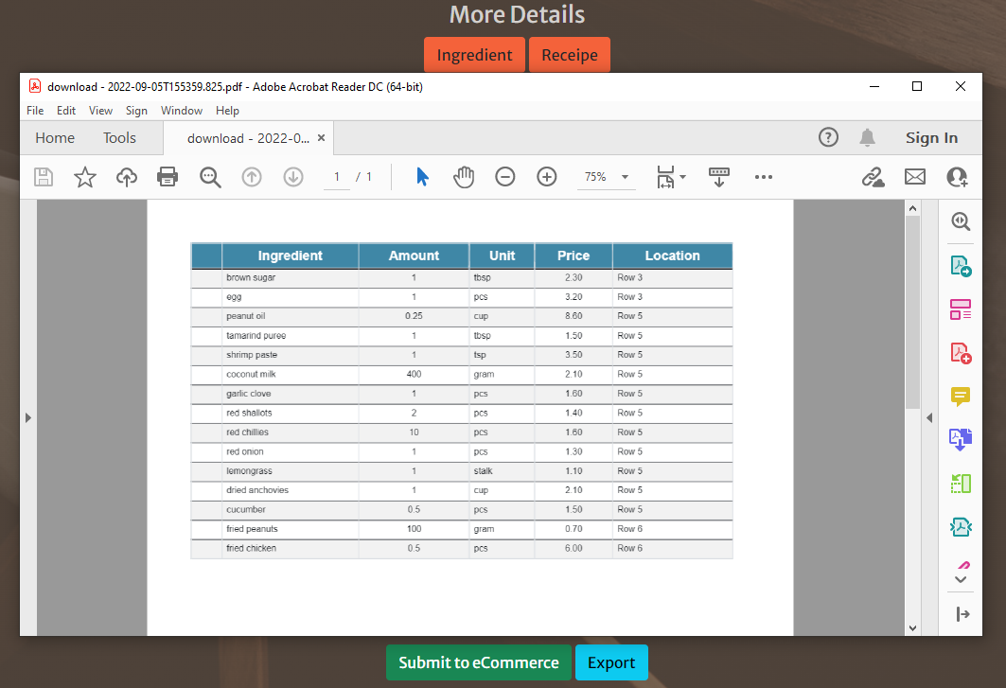
APPLICATION FLOW DETAILS –FLASK FRAMEWORK (Method 1: POST, PREDICTION)
Ingredient
Submit Online
Method 1
Browser
User click on ingredient button to see the ingredient required for the predicted result
User can then check the ingredient needed and submit the order to the supermarket ecommerce site
Otherwise user can export the ingredient and reference to it later
Recipe can only be exported in PDF
Export PDF
PDF
Notes:
(READ from point 20).
Resulting in the image in the top left.
(READ from point 21).
Resulting in the image in the top right.
(READ from point 22).
Resulting in the image in the bottom left.
(READ from point 23).
Resulting in the image in the bottom right.
I hope this illustration demonstrates clearly how flask is utilized in merging python application with HTML in method 1.

Slide 45
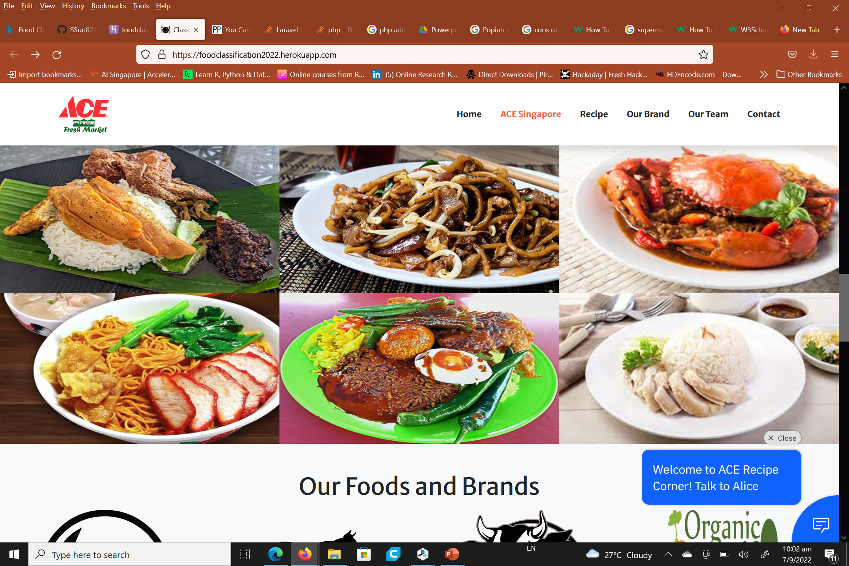
APPLICATION FLOW DETAILS – FLASK FRAMEWORK (method 2: DISPLAYPREDICTION)
Method 2
Browser
Heroku
Browser
Our Recipe
index.html
app.py
As the website start, python import Flask Library and executed default route “/”, causing main_page() function to render index.html. main_page() function is waiting for a POST action (i.e. submit action)
At the user browse, the website will display the welcome page with a button for user to upload image of food
More content in the page like image of foods for user to click to see its details are also being display
DISPLAYPREDICT function
From the Json Object,
extract and display the predicted result text
extract uploaded image filename, reference the filename to the image in the “uploads” folder and display the image
Use the predicted result and perform a Wiki API via AJAX to fetch the content description and display the content
…
User click on an image in index.html
A call was made to the displaypredict() function with 2 parameters
Param1: food name
Param2: button to display
Assign the parameters in a json object
Render predict.html and pass over the json object
Notes:
Earlier I have discussed method 1 where we uploaded the image.
Method 2 demonstrate CLICKING on the RECIPE Image to serve the prediction.
Point 1 to 3 is the same as Method 1. I would start from point 4.
(From point 4) When user CLICK on the image on the RECIPE portion in our site. (READ point 5 to 10)

Slide 46
APPLICATION FLOW DETAILS – FLASK FRAMEWORK (method 2: DISPLAYPREDICTION)
Method 2
Browser
1. Uploaded Image
2. Predicted Result
The result will pull us automatically to the predict page.
3. Wiki Content
4. Button
Notes:
(Read point 10) This will then display the prediction page.
Method 2 is pretty much the same as the Method 1 with the exception of the displaypredict() function where we sent our own image internally compared to uploading one from user.
This concludes both methods of initializing and displaying the “Prediction” function.

Slide 47
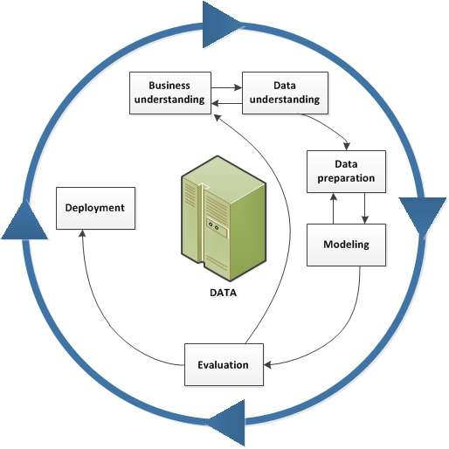
Our Prediction Model
Our team chose the BINARY CLASSIFICATION model
Our model then fed more than 1,000 images of “Char Kway Teow” and “Nasi Lemak” and the deep learning algorithm learns to differentiate between the two types of images
Notes:
I will now discuss the prediction mode. Read the above first.
As Part of the CRISP Methodology we used, we shall now discuss aspects of the cycle from Data Understanding to Modelling.

Slide 48

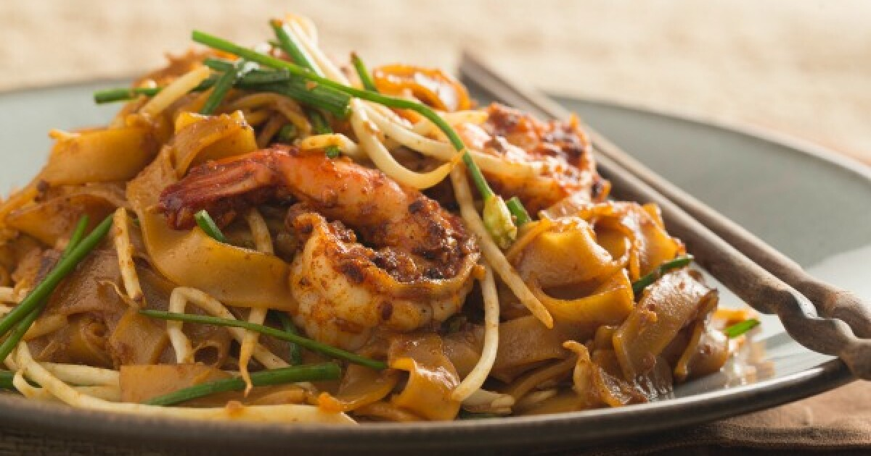

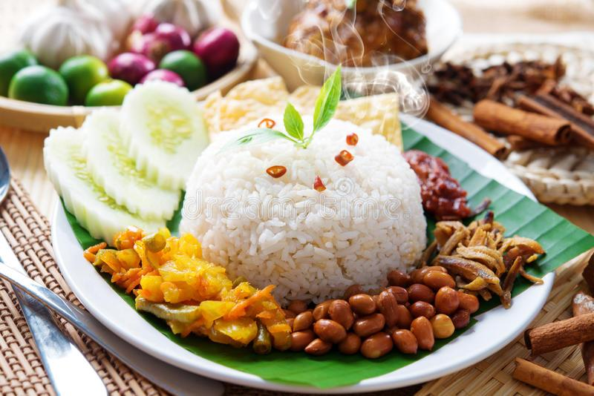
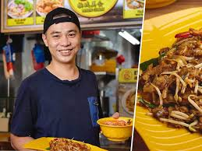
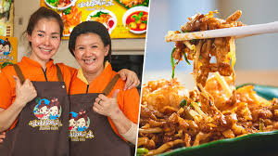
Data Understanding
Since our Image Classification is either “Nasi-Lemak” or “Char-Kway-Teow”
We had to “mine” our dataset. Over 1000+ images of both dishes were taken from “Google Images”
This could have been a manual and tedious process. A process involving saving individual images and vetting them. But an extension of Google Chrome was used (Image Downloader) that enabled us to BULK download the search returns from “Google Image”.

Slide 49
DATA CLEANSING
The images taken from “Google Images” contained all the returned images from the search term.
They included:
Pictures of people with both dishes.
Mixed pictures of the dishes with other objects in the same frame.
Objects that had the same name as our search term.
Solution
Manually remove the unwanted images.
This is an important process to have the dataset cleanse. Unwanted images can throw our prediction off.
UNWANTED
WANTED
SORTED

Slide 50
DATA PREPARATION
Cleansed Dataset
We numbered our images from 1 to N set (depended upon the number of images we have).
Used a console BAT file to renumber original file names sequentially.
Our “Cleansed” data are then separated into the following segments.
Training Set
Testing Set
Scoring Set
(Lo123.jpg) , (2jfds.jpg) to become 1.jpg , 2.jpg
Training set:
Char Kway Teow (500 pix)
Nasi Lemak (500 pix)
Testing set:
Char Kway Teow (40 pix)
Nasi Lemak (40 pix)
Scoring set:
Char Kway Teow (4 pix)
Nasi Lemak (4 pix)

Slide 51
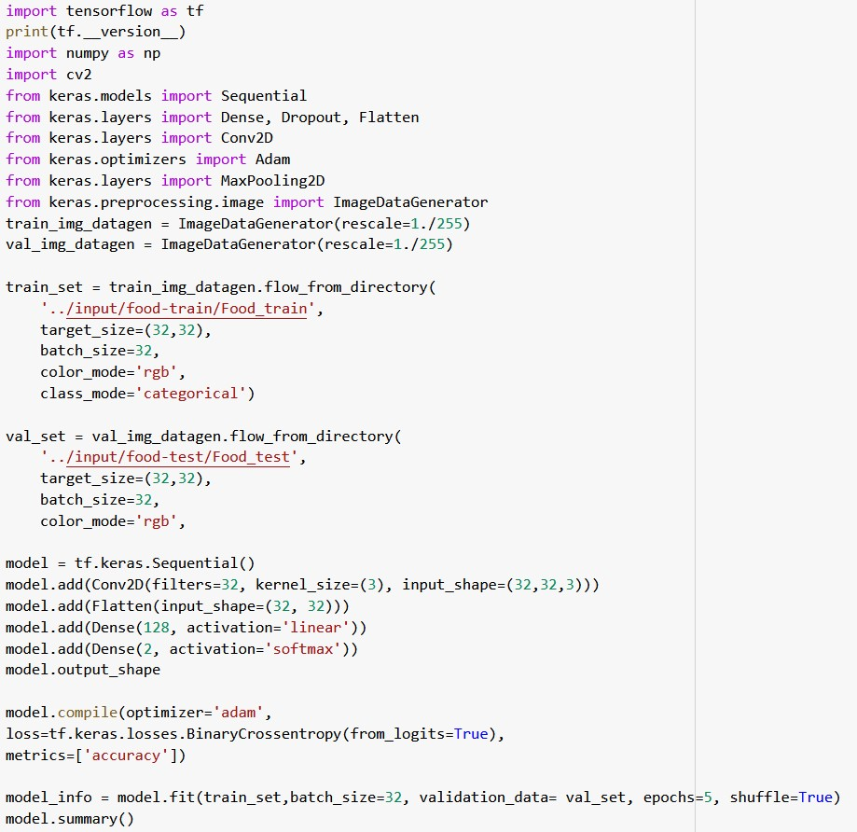
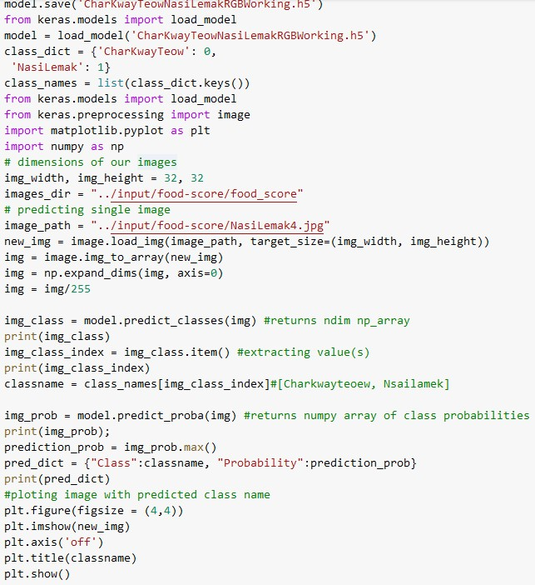
Tuning and testing the deep learning Prediction model
Most of us know the codes here as we all have copies. We would like to discuss the model used and the hyperparameters that we altered to get the best results.
Notes:
We all recognized this code and we will not go through them.
I will discuss the hyperparameters that we amended to achieve optimal results for our model.
In any test that we performed. We ensured that the results can be replicated and not a one-off. Say Chao and I tested the following variables to ensure the results were replicable.

Slide 52
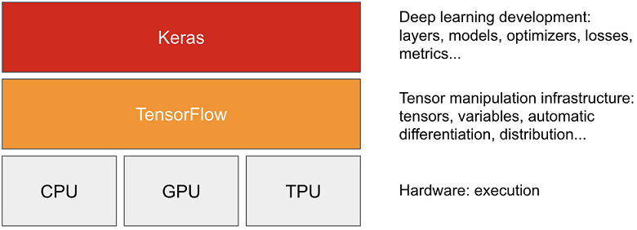


Tuning and testing the deep learning Prediction model
Line 1: model = tf.keras.Sequential()
Model accesses Sequential mode inside Keras library bundled within TensorFlow.
TensorFlow is a free and open-source software library used for creating neural networks and deep learning models.
Keras is an open-source high level software library that provides a Python interface for artificial neural networks like TensorFlow. It represents the actual neural network development and provides 2 modes (i) Sequential mode and (ii) Functional mode.
The Sequential mode is simple and easy to use as it arranges the layers in a linear stack of layers and is used to create models layer-by-layer. Data flows from one layer to another layer in a given order until the data finally reaches the output layer
The Functional mode is used to create more complex models where it allows multiple input and outputs that share layers. Eg, branching off main branch and have child nodes.
For our business outcome, it is a simple binary classification model. Hence, the sequential mode is chosen
Notes:
I will attempt to explain line by line from the code highlighted.
For line 1 in the code. READ The model access…
----- Additional if asked
TPU = Tensor Processing Units – processor developed by google for AI

Slide 53

Tuning and testing the deep learning Prediction model
Line 2: model.add(Conv2D(filters=32, kernel_size=(3), input_shape=(32,32,3)))
In Line 2, “Model.add” adds an input layer to the model as the model needs to know what input shape it should expect
“Conv2D” creates a 2D convoluted layer to extract fundamental features of the image for the CNN to process
“filters” are the number of Convolutional filters in that layer. ie 32 features in this case
“kernel_size” specifies the height and width of the 2D convolution window the size of image used as features ie 3x3 in this case
“input_shape” defines the size of the images ie (32 pixels x 32 pixels x 3 [RGB])
The final numbers for the above hyperparameters were obtained through a series of model testing that gave the highest accuracy subject to memory constraints.
Kernel Size
(3,3)
Input Shape
(32,32,3)
Convolutional Layer
Notes:
In Line 2 (READ) “Model.add …” from above.
----
Additional Information
Kernel Size is 2D while Filters are 3D (Stack of Kernel sizes)
The output of a convolution layer is referred to as a feature map.
The activation maps are also called feature maps. They capture features from the input. Eg, sharpness / Edges.
Filters are also known as features detectors.
Max pooling is a pooling operation that selects the maximum element from the region of the feature map covered by the filter. Thus, the output after max-pooling layer would be a feature map containing the most prominent features of the previous feature map. It is useful when the background of the image is dark. (why we don’t use. Ours not dark)

Slide 54
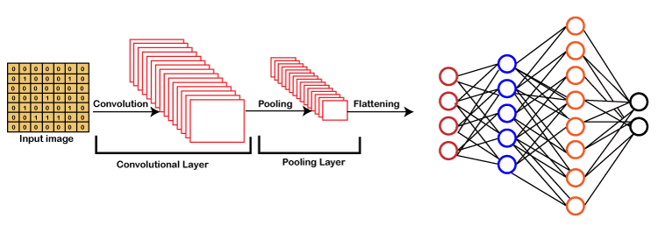
Tuning and testing the deep learning Prediction model
Line 3: model.add(Flatten(input_shape=(32,32)))
In Line 3, “model.add” adds a hidden layer to the model
In this hidden layer, the “Flatten” function is an important function to deal with multi-dimensional inputs such as image datasets. It flattens them into a single dimension and pass the data into every single neuron of the model.
Line 4: model.add(Dense(128, activation=‘linear’))
In Line 4, “model.add” adds a second hidden layer
In this hidden layer, the “Dense” function (with 2 parameters) performs the calculations which lead to parameters that can be trained and updated with the help of backpropagation.
The first parameter “128” represents the output size of the layer which was selected because it provided the highest accuracy while being within the Heroku overall size limit. One observation we had was that higher number of dense nodes will result in higher file sizes, slower training time but better accuracy
DENSE LAYER
Notes:
READ Line 3.
READ Line 4.

Slide 55
Tuning and testing the deep learning Prediction model
Activation Function | Accuracy
ReLu | 88%
Elu | 87%
Exponential | 50%
Selu | 50%
Sigmoid | 54%
Linear | 90%
Tanh | 52%
Swish | 51%
Softplus | 54%
Serialised | NIL
We then tried adding an additional hidden layer with another dense function to see if this extra dense layer can improve the accuracy of the model. However, we found that this additional layer decreased the model accuracy for all the nodes from 64 to 2048. Hence, we decided not to have this second dense layer in the model.
The second parameter “activation=‘linear’” controls how well the network model learns from the training dataset.
An activation function is a function that is added into an artificial neural network in order to help the network learn complex patterns in the data. It takes in the output signal from the previous cell and converts it into some form that can be taken as input to the next cell.
We tried the other keras activation functions recommended from websites and blogs such as “ReLu, Sigmoid and Tanh. But it didn’t perform to our satisfaction. We then tried the functions in the table and selected linear because it gave the highest accuracy.

Slide 56
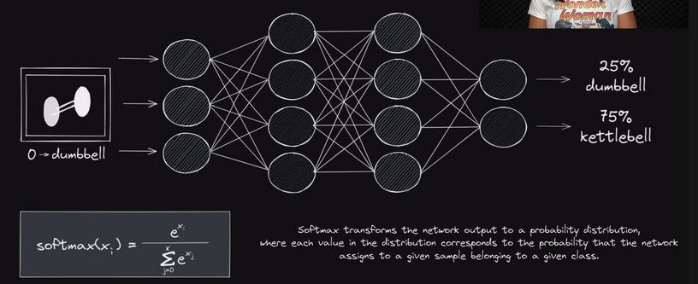
Tuning and testing the deep learning Prediction model
Line 5: model.add(Dense(2, activation=‘softmax’))
In Line 5, model.add adds the output layer and because a binary prediction is required, the output layer is defined to have only 2 nodes
Softmax activation is used as softmax is a more generalised form of the sigmoid function used in class classification problems. Similar to sigmoid, it produces values in the range of 0–1 therefore it is used as the final layer in classification models.
Testing the model with unseen data
At each stage, we also used data from the Scoring set (unseen data) to make sure that the model provides the correct prediction on the unseen data.
Nasi Lemak
Char Kway Teow
Nasi Lemak

Slide 57
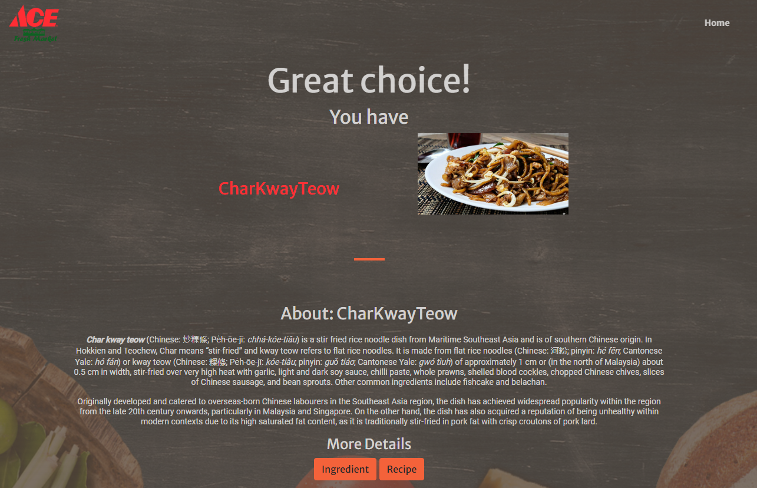
PREDICTION RESULT
Notes:
All the functions from the code is then able to produce the correction prediction based on the uploaded image shown above.
I shall pass the mic to Julia, who shall be bringing you through the Chatbot functionality. Over to you Julia, Thanks!

Slide 58
SECTION 7: CHATBOT DESIGN, IMPLEMENTATION AND DEPLOYMENT
Notes:
Thank you Colin to share about application framework. Next, we will talk about CHATBOT DESIGN, IMPLEMENTATION AND DEPLOYMENT

Slide 59
Chatbot purpose and design
Purpose of chatbot | Chatbot feature
Provide enhanced 24/7 customer engagement at the convenience of the customer + relieve staff from routine work | Allows customers to query information about their favourite Singapore foods Provides recipe suggestions for favourite Singaporean food and list of ingredients required Tells context-specific jokes to engage customer and informs customer on latest promotions and where items are located in the store Provides answers to FAQs for customers in real time for example store locations, opening hours etc Allows feedback channel for customers to provide both positive and negative feedback
Increase supermarket sales | Ingredient list is conveniently linked to the supermarket e-commerce website for customer to order online with ingredients needed pre-filled Sends a downloaded copy to customer’s device if the customer wants to visit a physical store to buy
Notes:
First, let’s look at the Purpose and features of chatbot
The first Purpose of chatbot is
Provide enhanced 24/7 customer engagement at the convenience of the customer + relieve staff from routine work
Features include:
Allows customers to query information about their favourite Singapore foods
Provides recipe suggestions for favourite Singaporean food and list of ingredients required
Tells context-specific jokes to engage customer and (in the next phase) informs customer on latest promotions and where items are located in the store
Provides answers to FAQs for customers in real time for example store locations, opening hours etc
Allows feedback channel for customers to provide both positive and negative feedback
The second Purpose of chatbot is
Increase supermarket sales
Features include:
Ingredient list is conveniently linked to the supermarket e-commerce website for customer to order online with ingredients needed pre-filled
Sends a downloaded copy to customer’s device if the customer wants to visit a physical store to buy

Slide 60
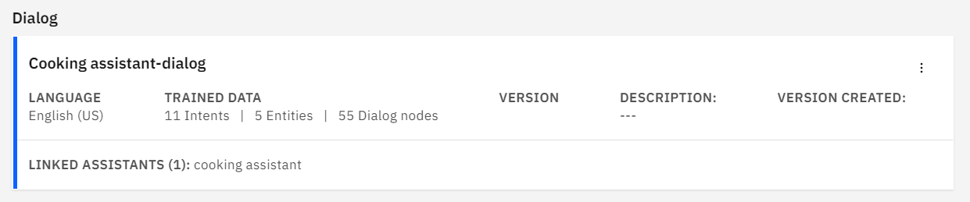
Chatbot creation on Watson assistant
Notes:
This is the general information of our chatbot.
In our chatbot design, there are 11 intents, 5 entities, and 55 dialog nodes. We will describe the details later.

Slide 61
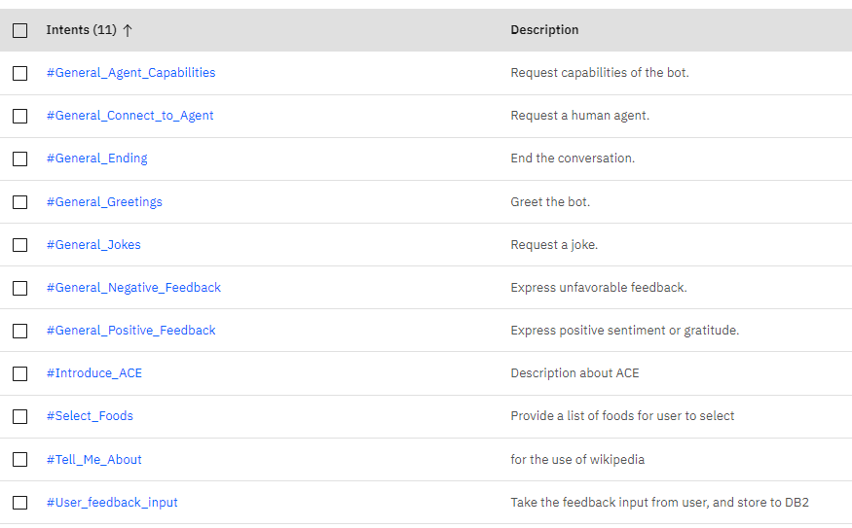
DIALOGUE CREATION - INTENTS
1
2
3
4
5
6
7
8
9
10
11
Notes:
This is the list of the intents, which summarizes the intentions of the user when they talk to ChatBot, ChatBot then offer various services and actions accordingly. We will see them in the dialog design later.

Slide 62
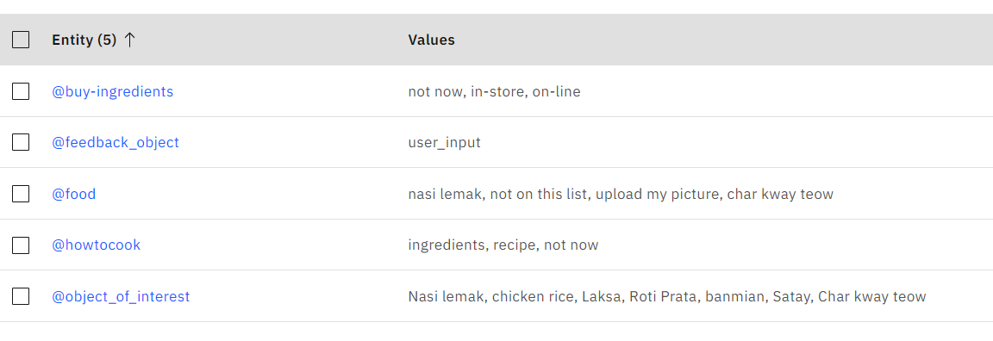
DIALOGUE CREATION - ENTITIES
Notes:
This is the list of entities, they are variables of the user’s selection when they ask for certain services. we will also see them in the dialog design later.

Slide 63
OVERVIEW OF CONVERSATION FLOW
First-layer nodes
If: #Select_Foods
Then: ask user to select food to explore
If: ‘Char kway teow(CKT)’
Then: -display CKT info (through Webhook)
-ask user want to view recipe?
If: yes
Then: -display CKT recipe
-ask user want to view ingredients?
If: yes
Then: -display CKT ingredients
-ask user want to buy ingredients?
User input
If: #General_Jokes
Then: show food jokes
If: ‘Nasi Lemak(NL)’
Then: -display NL info (through Webhook)
-ask user want to view recipe?
Same as CKT
If: ‘yes, on-line’
Then: link to our e-commerce web page to submit shopping list
If: ‘yes, in-store’
Then: link to our web page to download ingredients
If: #Tell_Me_About
Then: call out to webhook to get info from Wikipedia
Cloud function to pull text and picture from Wikipedia
Webhook
If: #General_Greetings
#General_Ending
#General_Connect_to_Agent
#General_Feedback
Response accordingly
Notes:
This is the OVERVIEW OF CONVERSATION FLOW
When user types in something, the dialog flow will go to the first-layer nodes, there are 4 groups of first-layer nodes.
If the bot identifies the intent of the user is #select_food, the flow goes to the first node, the bot ask user to select food from a menu. In the current demo version, we have two foods to select: “CKT” and “NL”. If user selects CKT, the bot display CKT info from wiki, then bot asks user whether he wants to view recipe? If user says yes, bot shows recipe and asks user whether he wants to view ingredients? If user says yes,
The bot then shows ingredients, and asks user whether he wants to buy ingredients? If user wants to buy on-line, the bot directs user to our e-commerce web page, for user to submit shopping list.
If user wants to buy in-store, the bot then directs user to our web page to download ingredients.
If the bot identifies the intent of the user is #Tell_me_about, the flow goes to the third node, the bot then calls out to cloud function through webhook to get info from Wikipedia.
If the bot identifies the intent of the user is from the group of #general intents, the bot will response accordingly, we will describe the details later.

Slide 64
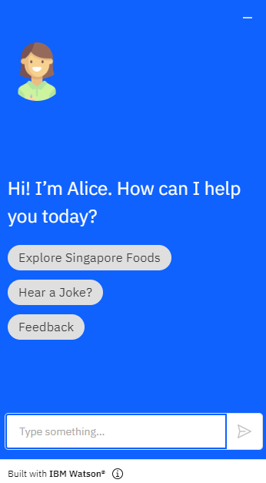
TRANSLATING CONVERSATION FLOW TO DIALOG NODES
Hello, I'm Alice, your virtual Singapore Food recipe assistant. I can tell you more about the different types of food in Singapore and help you look these recipes if you like. What shall I call you?
Types “Hi!”
(4.#General_Greetings)
[Stores username]
Hello, Adam! It's lovely to meet you. How can I help you today?
Types “Adam”
Clicks “Explore Singapore Foods”
(9. #Select_Foods)
Types “tell me about your company”
Go to next page
[Introduces ACE store with embedded picture.
8. #Introduce_ACE]
Clicks “Hear a Joke!”
(5. #General_Jokes)
[Shows a context specific joke which also adds information about latest promotions and where this item can be located in the supermarket]
Key:
Clicks “Feedback”
(11.#User_feedback_input)
Direct user to ACE webpage feedback area to type in and submit feedback
User input
Chatbot
Notes:
In this slide, we elaborate a bit more details about the conversational flow. The blocks in grey color are the inputs or actions from the user. The blocks in green color is the response and actions from ChatBot.
If user types HI, the bot identifies the intent of the user is the #general greetings, it will provide brief information about this chatbot, and remembers user’s name, provide detailed information about the company if user asks.
If the bot identifies the intent of the user is #general_jokes, the flow goes to the second node, the bot then shows a context specific joke which also adds information about latest promotions and where this item can be located in the supermarket.
If user types or clicks feedback, the bot will direct user to ACE webpage feedback area, for the user to type in and submit feedback.
In this slide, we elaborate a bit more details about the conversational flow.
If user types HI, the bot identifies the intent of the user is the #general_greetings, it will provide brief services provided by this virtual assistant, and remembers user’s name for later conversation. It also provides detailed information about the company if user asks.
If the bot identifies the intent of the user is #general_jokes, the flow goes to the third node, the bot then shows a context specific joke which also adds information about latest promotions and where this item can be located in the supermarket.
If user types or clicks feedback, the bot will direct user to ACE webpage feedback area, for the user to type in and submit feedback.

Slide 65
#SELECT_FOODS
Here are some Singaporean food suggestions.
Please select: [Char kway teow/ Nasi Lemak/ Not on this list/ Upload my picture]
Clicks “Char kway teow” or “Nasi Lemak”
Clicks “Not on this list”
Clicks “Upload my picture”
Display Wikipedia information 10. #Tell_Me_About]
Do you want to see the recipe? [Yes/Not now]
Clicks “Yes”
[Provides relevant recipe] Do you want to see the ingredients to cook [dish]? [Yes/Not now]
Clicks “Yes”
Clicks “Not now”
[Provides ingredients]
Do you want to buy these ingredients? Please select one: [Buy online/ Buy from store. Download recipe to my device /Not now]
Anything else I can help you with?
Please upload your picture onto our web page at the centre of your screen.
Clicks “Buy online”
Clicks “Buy from store”
[Link to e-commerce website]
[Link to website to download ingredients list to device]
Notes:
#select_food is the major intent in our ChatBot design. This slides shows the complete flow when the ChatBot identifies such intent from the user.
Previously, we have described the flow on the left part. If user wants to quit from this flow by selecting “not on the list” or “not now” anytime, the flows will go to the middle part, to ask user if anything the bot can assist. If user chooses to upload his own food picture, the bot then asks user to upload picture onto our web page at the centre of screen.

Slide 66
OTHER DIALOG NODES
Types “Can I speak to your manager”
(2. #General_Connect_to_Agent)
Our customer hotline is 6666 8888 (toll free). Your enquiry is important to us. Thank you for visiting our website.
Types a negative comment (e.g. not so good)
(6. #General_Negative_ Feedback)
We’re sorry that we are not able to meet your expectations. Your feedback is important to us, could we trouble you to send your feedback through Feedback so that we will have some one follow up this for you?
Types in a compliment (e.g. good job)
(7. #General_Positive Feedback)
Oh! Thank you very much. Could we trouble you to send your feedback through Feedback in our website?
Types “Bye!”
(3. #General_Ending)
Thank you for visiting our website. Hope to see you again!
Notes:
Let’s have a look at the other dialog nodes to handle general intents.
If user wants to talk to a staff or manager, the bot tells him the hotline number.
If user types in negative or positive comments, the bot responses accordingly and directs user to the webpage feedback portion.

Slide 67
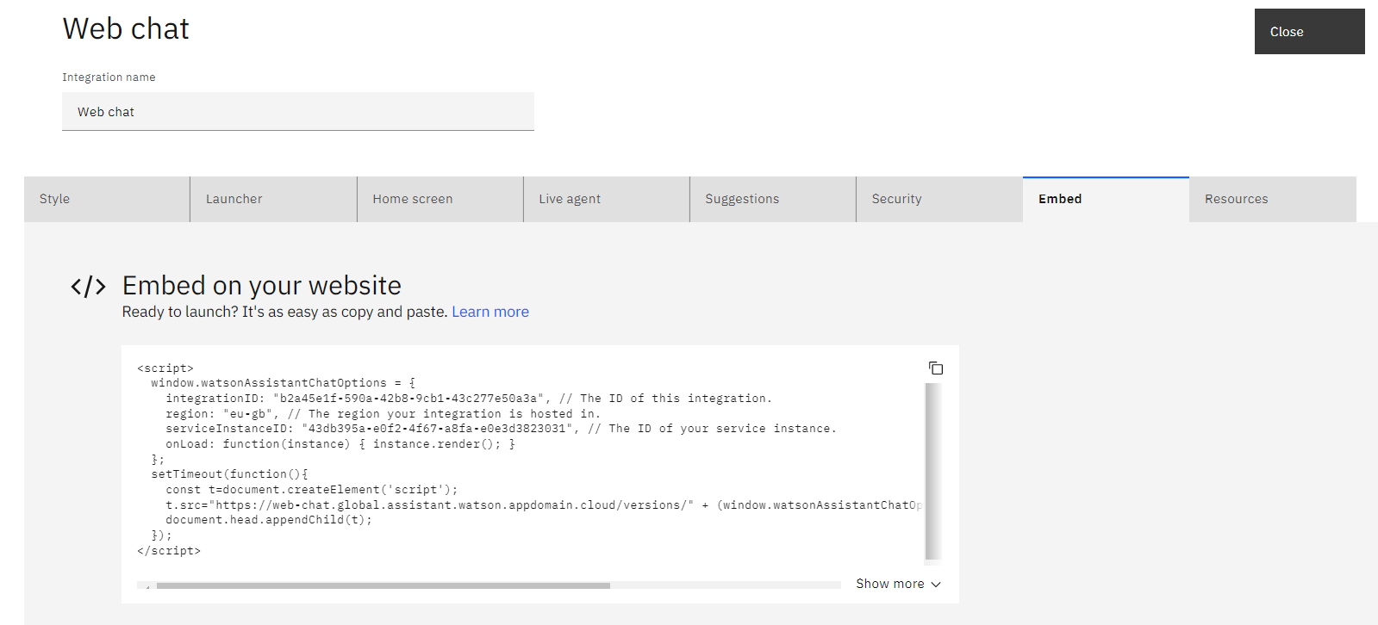
EMBEDDING CHATBOT ONTO WEBSITE
To embed chatbot onto website, just copy the following JavaScript and paste onto the index.html
Notes:
Usually a chatbot is shown on a website.
To embed chatbot onto a website, the developer just needs to copy the following JavaScript provided by Watson Assistant, and paste onto the webpage index.html, the chatbot will be displayed on the webpage.

Slide 68

CHATBOT INTEGRATION / TECHNICAL ARCHITECTURE
User Devices
Browser
Heroku
IBM Services
Other Services
JavaScript
Integration
Wiki
Webhook
Web Server
Watson
Assistant
Cloud Function
DB2
powered by Python
and Keras
Notes:
This slide shows how Watson assistant is integrated with other components to build a service system.
The left-side part which is outside of the red box shows the integration with webpage, Say Chao and Colin has talked about it previously. On the right side, the part inside the red box shows how Watson assistant is integrated with other services in IBM cloud. Watson Assistant is linked with the cloud function through a Webhook, which is triggered by pre-determined actions. The cloud function then dispatches the services to various service blocks in IBM cloud. In this version, due to the time constraints, we haven’t finished the integration of Watson assistant and DB2. This will be developed in the next phase.

Slide 69
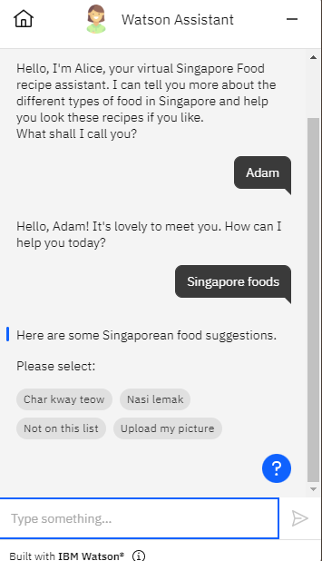
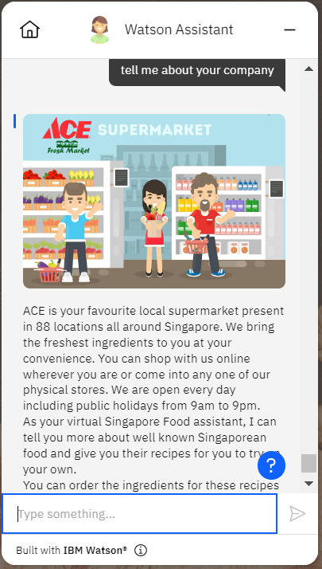
SAMPLE CHATBOT SCREENSHOTS – WELCOME SCREEN AND INTRODUCTIONS
Notes:
The following 3 slides show a few sample screenshots of chatbot conversations, which you have seen in our previous demo done by Say Chao.

Slide 70
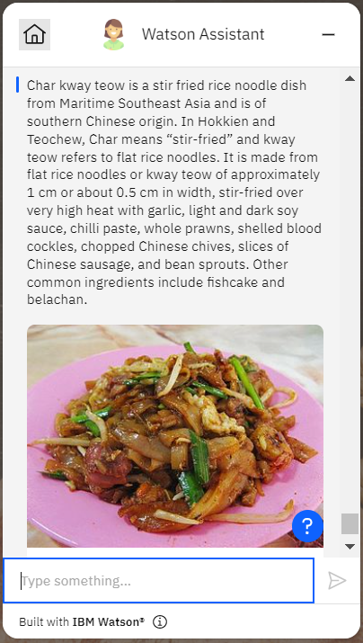
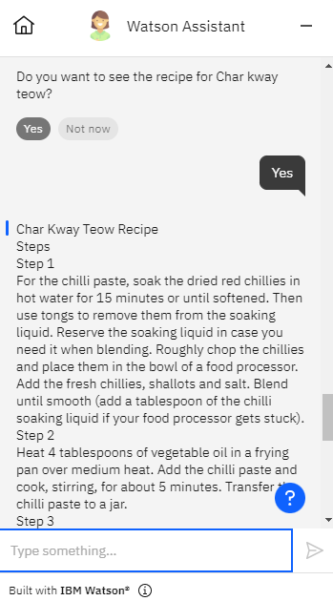
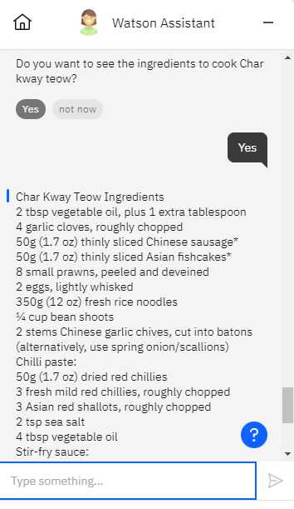

SAMPLE SCREENSHOTS – FOOD QUERIES LINKED TO E-COMMERCE WEBSITE

Slide 71



SAMPLE SCREENSHOTS – OTHER FEATURES
Tells context-specific jokes and provide information about latest promotions and location of items
Receive positive and negative feedback
Referring to a human agent
Notes:
Next, I will hand over to my colleague Say Chao to talk about future iterations.

Slide 72
Section 8: Future iterations / MVPs
Notes:
Thank you Julia for the detailed accounts of the Chatbot development and features.
I am going to brief thru the future iteration and MVPs that we had included in our plans

Slide 73
mvp Roadmap
MVP 1.0
AI prediction of customer favourite foods based on object recognition of pictures uploaded by customer
Provide recipe suggestions for food predicted or queried
Provide ingredient list for recipes
Allows customer to easily order from website or chatbot by integrating to supermarket e-commerce website
Chatbot allows engagement (through jokes), customers feedback and provides answers to customer FAQs in real time, 24/7
1.0
MVP 1.1
Include more foods for prediction and more recipes
Include prediction for non-food household items + common household hacks
Launch Chatbot report and Sales report for the retail manager to perform data analytics
Integrate DB2 into the chatbot
1.1
MVP 2.0
Launch customer loyalty programme
In-store tracking of customer behaviour and AI to push personalise promotions in-store
AI to provide recommendations for item placement
Allows seamless customer checkouts using app
2.0
Notes:
As mentioned earlier, we want to start small and roll out fast, we split our MVP into 3 pharses.
The demo show the current capabilities of our website and chatbot, which we are now in MVP 1.0
In this version, we are
Enabling the customer to upload image of food and predict the food type
Based on the predicted food type, the website show the brief summary of the food and also provide ingredient list and recipe suggestion. Customer can place order for the ingredient thru this App to the supermarket ecommerce site.
A chatbot to engage with customer for self-service 24/7
In MVP 1.1, we will
update our model to a multiclass image classification to add in more food and also to add class to handle the negative image
we also intent to add non-food items as well as common household hack so that customer might find it more useful to them and with more product, it should indirectly increase the supermarket sales
we would also have the Chatbot report, Sales report for data analytic
We will also integrate DB2 into the chatbot
In the final MVP2.0, we are planning
to launch the customer loyalty program
with loyalty program, customer register with the supermarket and with it, then we can have in-store tracking and monitoring of the customer behavior and thus can push personalize promotion
As we track customer behavior, we can also recommend store manager with their item placement to boost sales
The ability to perform self-checkout using our applicaation is also part of our plan

Slide 74


Chatbot report (MVP 1.1)
CHATBOT REPORT
Reporting
- Chatbot Report
Set Date Range
- Sales Report
620
Legend
350
Enquiries handled <5mins
250
Conversion Rate
Enquiries handled >15mins
80
Conversion Rate
Sep 11, 2022
(8.00am to 10.00am)
Notes:
Since we are capturing data of the supermarket customers and we want to enable the store manager to make better decisions with data
Under Reporting, click on ChatBot report and choosing the date will show
how long the chat dialog last.
And if the chat convert into a sales
Clicking on the conversion rate, the report will show the sales breakdown into category.

Slide 75





Sales report (MVP 1.1)
SALES REPORT
Reporting
- Chatbot Report
Set Date Range
- Sales Report
15%
25%
38%
25%
Sep 11, 2022
(8.00am to 10.00am)
Notes:
This will enable the manager to understand what are the most common product that customer enquires over the chatbot and being converted to sales
Manager can also click on the Sales Report and select the Date Range to view the sales for the whole period. With this, the manager will have a feel, how much the App is bring the sales to the store

Slide 76











A SHOPPER’S FUTURE JOURNEY (MVP 2.0)
Brown Sugar
1 for $2.30
Direction
Walk cross 3 Racks
and Turn Left.
Item on Column 3 on Right Rack
Using Object detection and localisation to track Customer action
Get the food ingredient from the App and get to its location easily using LTB to guide the direction
Nearest LTB sync with APP when Customer get nearer
Push notification on targeted area promotion
Objection detection and location coupled with Image classification
to understand if product is taken off a shelf or put back into shelf
to update the customer virtual cart
System checkout cart upon customer exit and Push notification to customer on the purchase
Location Tracking Beacon (LTB) sync the App Identity
Exit
Entrance
Customer open App and scan QR code at Entrance
Notes:
Our Envision of a Shopper Journey in a Physical Store with MVP 2.0
[click]
Customer open App and scan QR Code on entering the Supermarket
Once scanned, the Location Tracking Beacon will sync with the App to obtain the customer identity
[click]
As the customer move around within the supermarket
Location Tracking Beacon sync the App identify and push personalise promotion on the area based on the customer historical purchase, search or chat
[click]
The object detection and localisation capabilities of the AI intelligence will track the customer behavior and action
This help the retail manager in understanding the flow in the store for future item placement consideration
[click]
Object detection, localisation coupled with image classification of the AI services will to understand if product is taken off the shelf or put back to update the customer virtual cart for cashier-less checkout
[click]
Once Location Tracker Beacon detect customer had left the supermarket store, it will perform a system checkout of the virtual cart and push notification to the customer on the purchase
These are roadmap we had planned on the following MVP.
I will now hand over to Colin to wrap up with the Project Learning. Colin Please

Slide 77
Section 9: Project learnings

Slide 78
CONSTRAINTS AND CHALLENGES
Memory limit constraints on various software (GitHub, Heroku)
Github – 25 MB file upload constraint was side-stepped through their desktop app to 100MB.
Heroku – We couldn’t move the upload size to more than 1MB likely due to the upload speed time. The workaround recommendations online is to create a AWS account to access a S3 storage. But given a short time span. This approach wasn’t feasible. Heroku’s loading time for development was also a factor, and we found a solution via hosting locally.
Dataset / Hosting size constraints
Image datasets limited to “Googled” images – There wasn’t enough time to go out and “shoot” many photos for our dataset to train. We had to use “Google Images” to get the dataset. The challenge then was to download them automatically vs manual method (Over 1000+ images), clean them and then rename them sequentially.
Limited Space on Heroku of 500MB was also a consideration. We couldn’t go for higher quality “prediction models” when led us to stick with a mid-tier model of 44MB.
Time (2 weeks+) allocated for the project – The timeline for the project was also a challenge to learn about
HTML + CSS + JavaScript
Python + Flask + KERAS and its libraries
Team-size: With a smaller team, we decided to start small but THINK BIG and Roll Out FAST. This contributed to our decision for the model choice.
Notes:
I shall go through our PROJECT’s Constraints and Challenges.
READ Point 1 - 4

Slide 79

PROJECT TAKEAWAYS
AI is deeply embedded in our everyday lives.
There are many available AI tools which we can use to augment and enhance our human capabilities, limited only to our own imagination.
With thoughtful Enterprise Design Thinking (EDT), businesses can use AI, cloud technologies and data science to bring higher value added products and services to their customers. Those business who don’t risk business failures.
Teamwork and sharing is critical to the success of a project as it maximises the expertise and experiences of all team members.
Start small but think BIG! Roll Out Fast!
This Photo by Unknown Author is licensed under CC BY
Notes:
(Read One) Examples exist in the way we shop through ecommerce or our very own phones. And there is no one I know of, that doesn’t have a handphone these days.
We found (Read two) One example of this, recently in the news where a AI-derived art-piece won 1st prize in an Art Competition. Like it or not. Governments are also using AI for cybersecurity and surveillance.
(Don’t Read three) For point three, For businesses who don’t embrace technology, risk business failure. In Singapore, Army Emart is going to Lazada for accessibility. Putting physical Army Shops at beach road at risk and potential business failures. We are seeing real-life cases locally.
(Point 4) – Though our team was small, we pulled through via delegation of duties and frank communication. Specifically, utilizing our expertise in each area. Say Chao from his developer role, Julia had programming from her past and Eugene’s corporate finance in guiding the team and “selling” the product.
On the last point: <CLICK – to show image of the spinx>
You all might be wondering why the image of the Sphinx. An ancient story went that the original figure was of a resting panther of their deities. But the reigning pharaoh wanted a statue of himself within a year or the head of the steward would roll. So he started with a model scale design and use an existing pharaoh head from another project to crown it off. It took 359 days and met the requirements.
We hope you all enjoyed the slides as much as we had making the project. “Start small but think BIG and ROLL OUT FAST!”

Slide 80

Questions & Answers

